Slide 1
Project in Practice (PIP)
Catalysis and computer
Marcus Nørgaard Weng, 5. år, Nanoscience

Slide 2
Table of Contents
Overview of the project
Weekly progress

Slide 3
Overview of the project
Big picture: Voltammograms of fuel cell with formic acid
Simulate HAE surfaces
Estimate energy of adsorbing each adsorbant
Based on DFT simulations
Fill up surface from lowest energy to highest energy
Incorporate steric hindrance somehow to make each subsequent adsorbant in the local area higher energetically
Keep track of adsorbates while varying the voltage on the RHE

Slide 4
Week 1
Understand aim of the project
Look at the data
Understand Jacks drawings
Start simulating surfaces

Slide 5
Week 3+4: First results Predicting energy from feature vector with XGBoost and LinReg
Hollow site adsorbates
Hydrogen
Oxygen
Possibly more in the future
Combined dataset?
How advanced model does the task require?
Model type | Training data | MAE(H & O) | MAE(H) | MAE(O)
XGBoost | H and O | 0.0583 | 0.0595 | 0.0569
 | H | - | 0.0558 | -
 | O | - | - | 0.0580
Linear Regression | H and O | 0.1044 | 0.1161 | 0.0928
 | H | - | 0.0439 | -
 | O | - | - | 0.0547
Notes:
Only 2x500 datapoints, so MAE varies a lot depending on luck of the draw in the test-set
Conclusion: XGBoost can handle combined datasets from several adsorbates
Opens the possibility for transfer learning
MAE numbers are averages on 100 with randomly drawn
Train/val/test sets each time

Slide 6
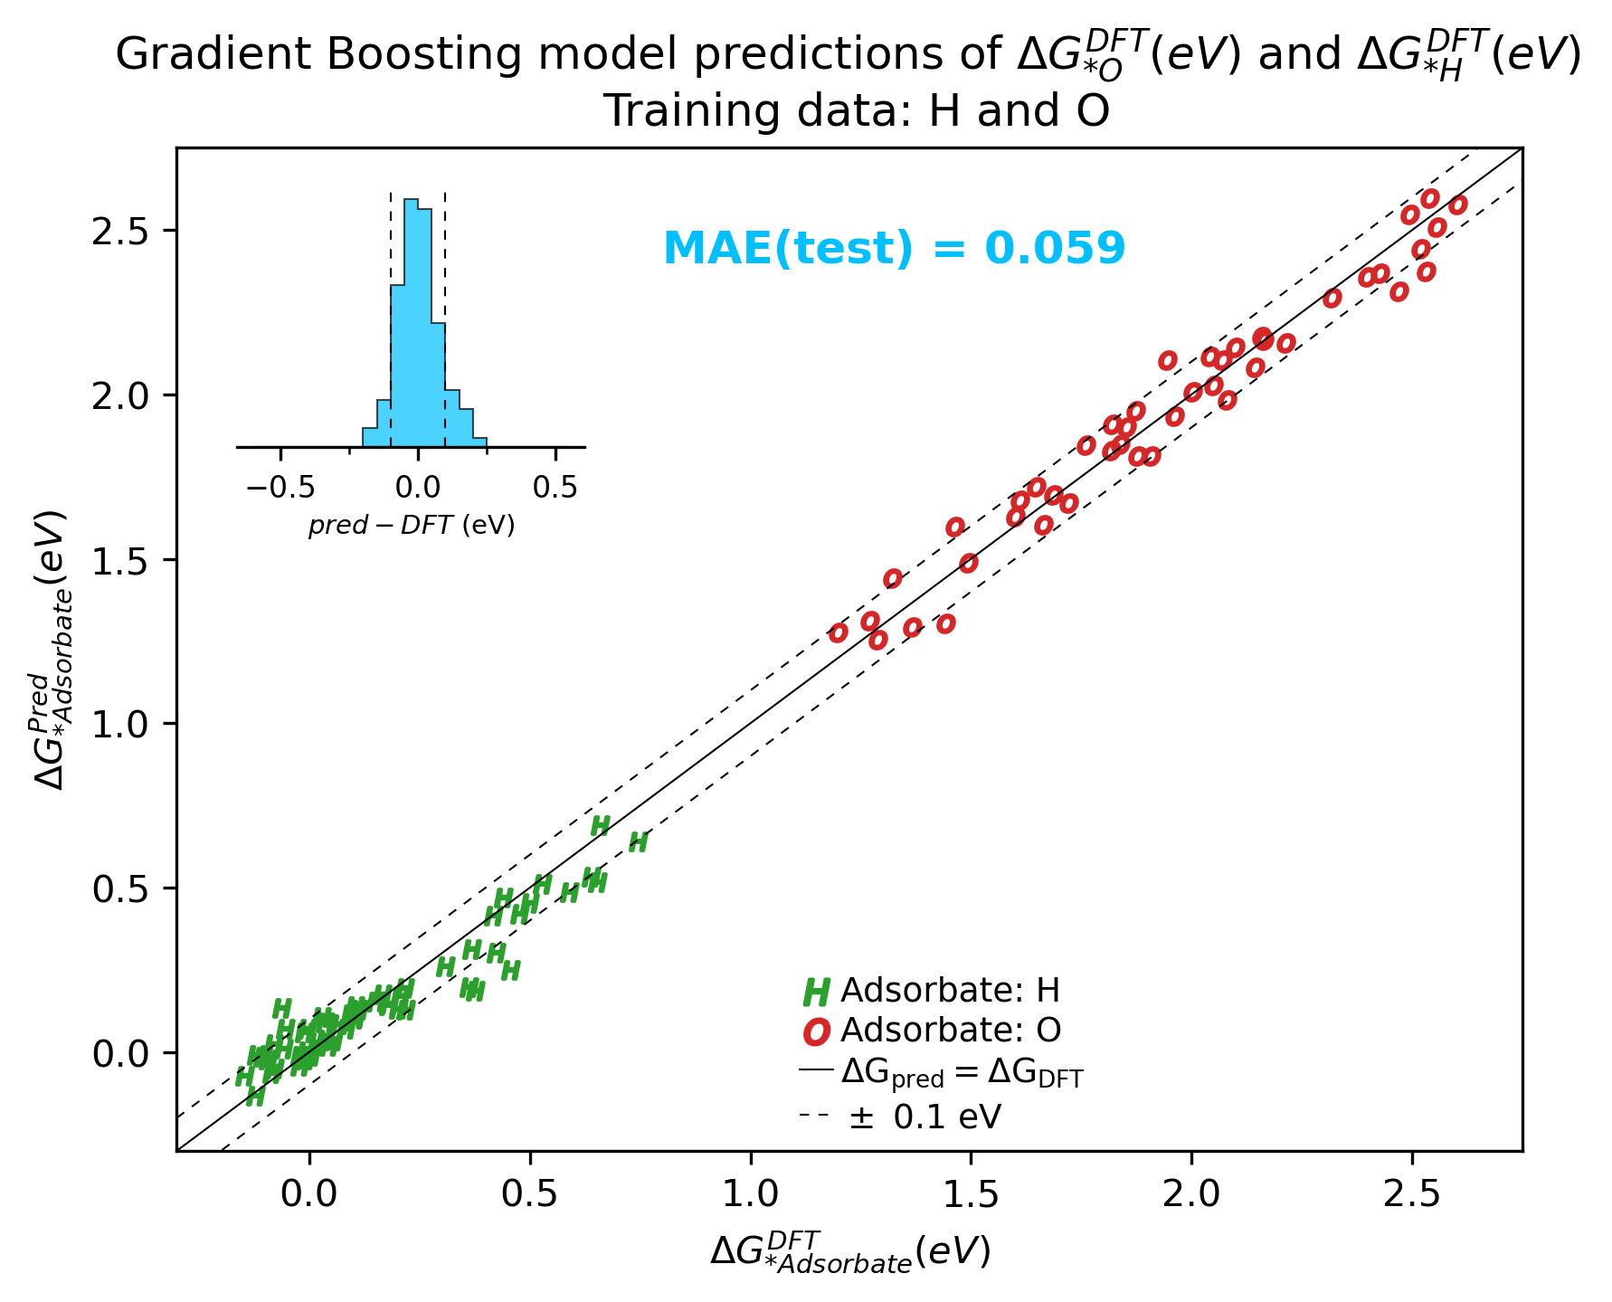
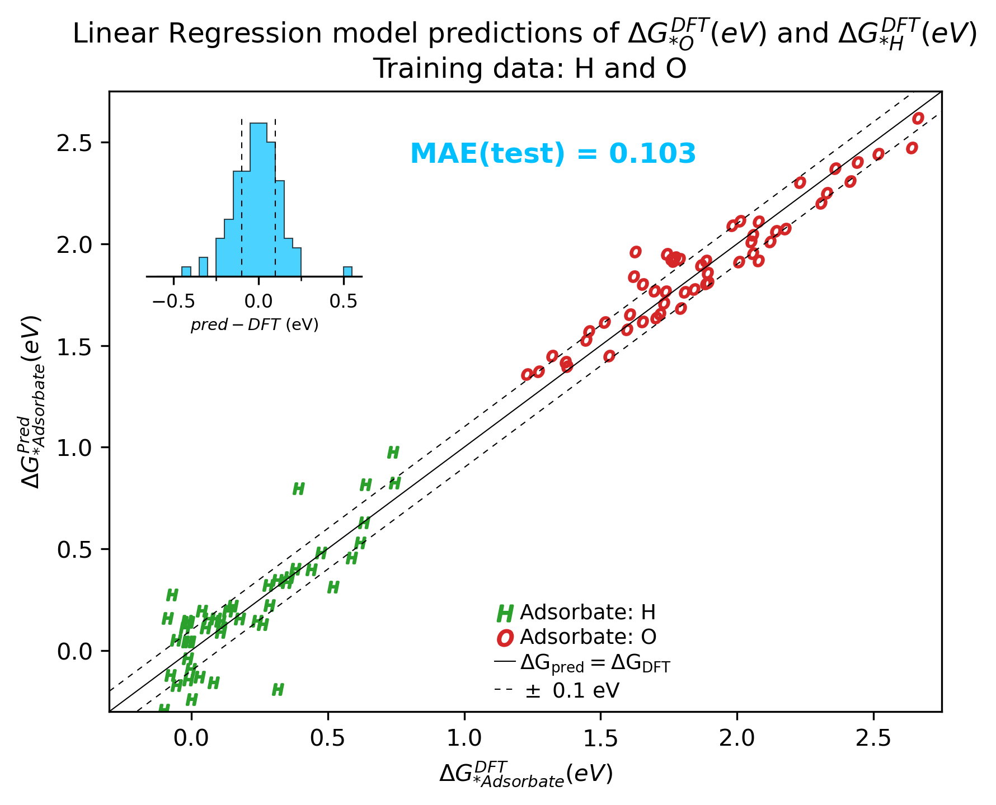
Combining O and H adsorption data:
Notes:
s

Slide 7
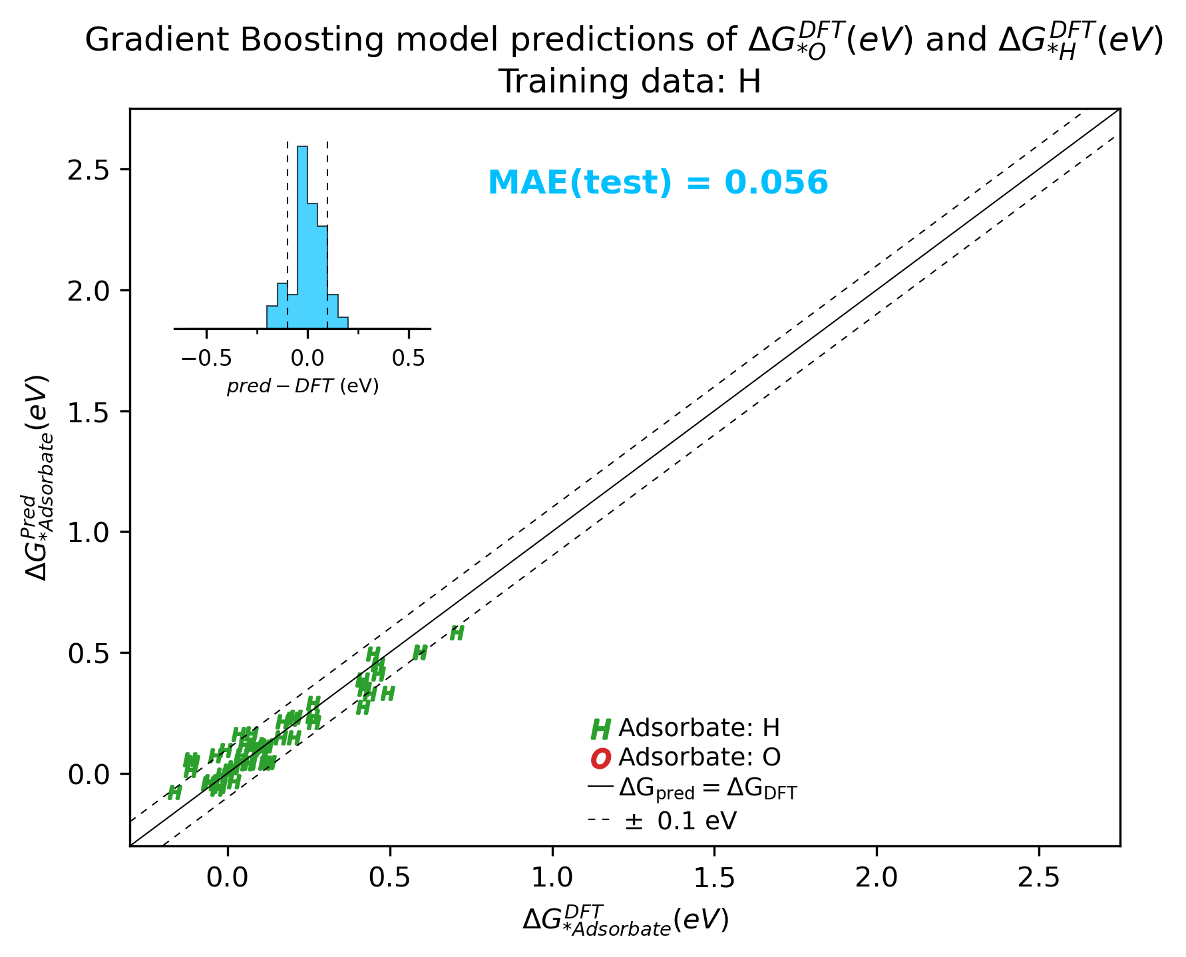
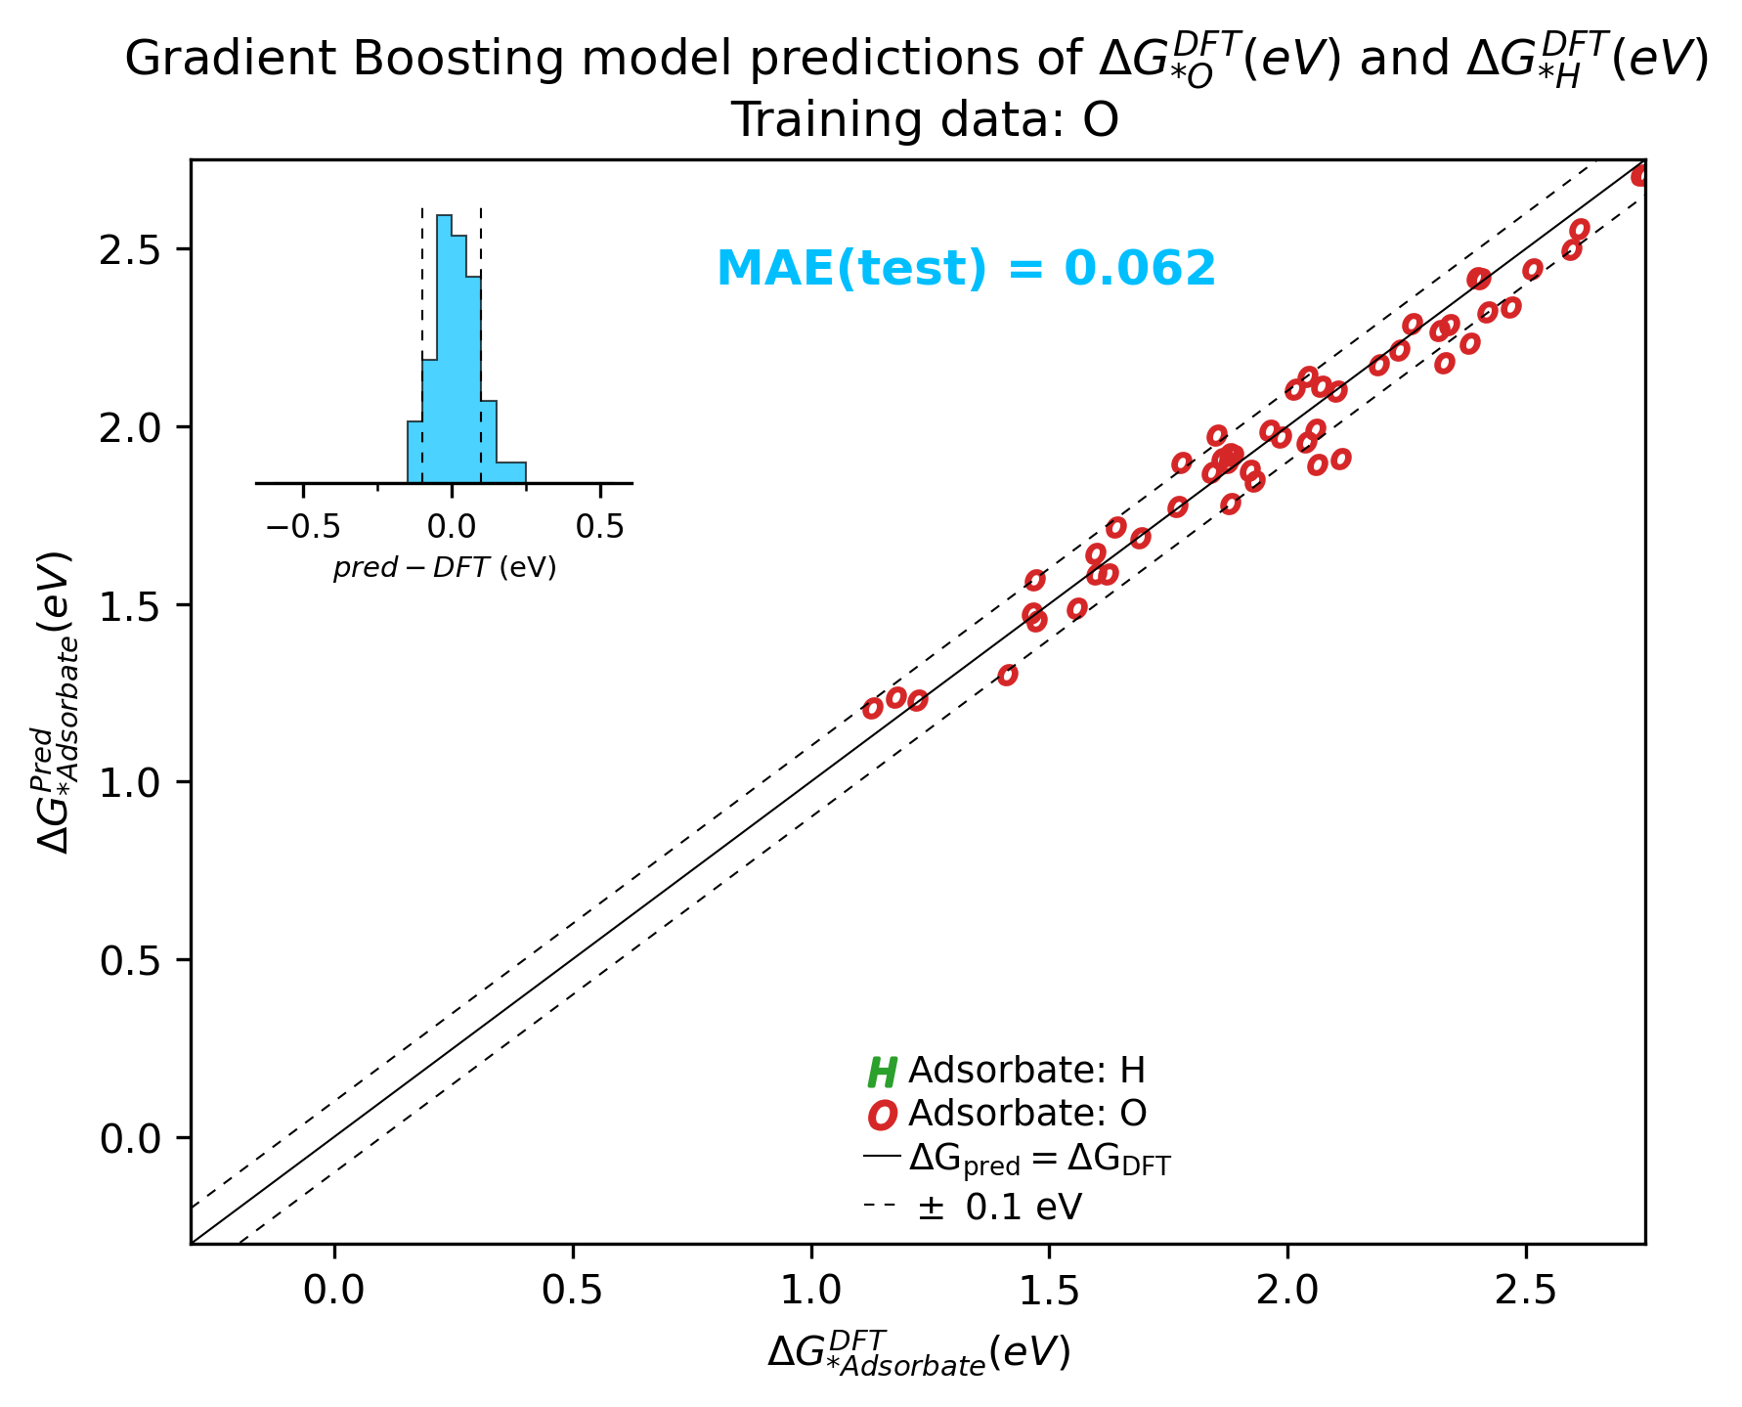
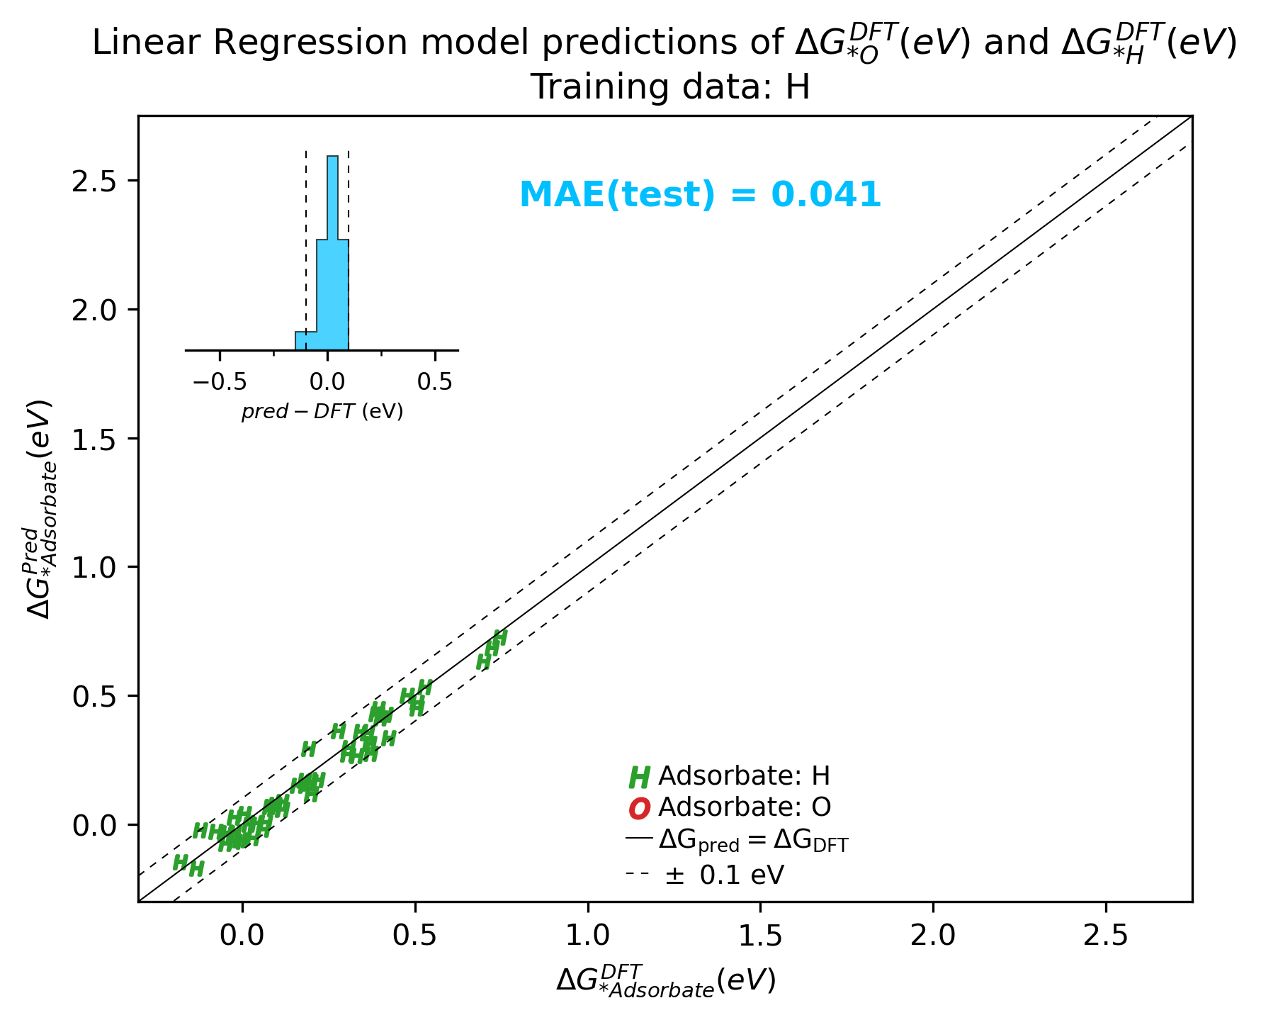
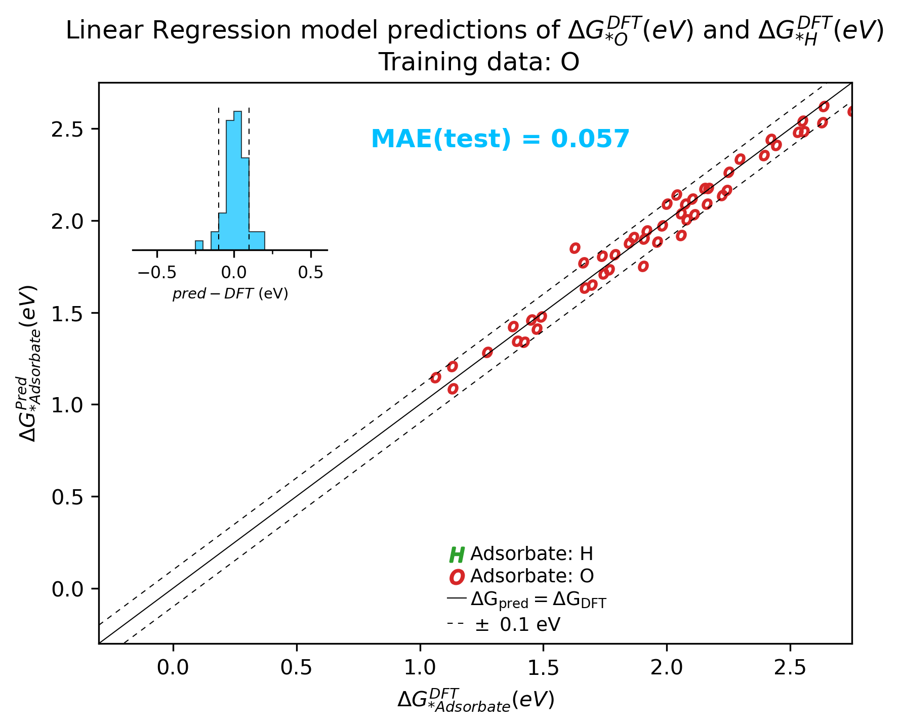
Predicting energy of H and O seperately

Slide 8
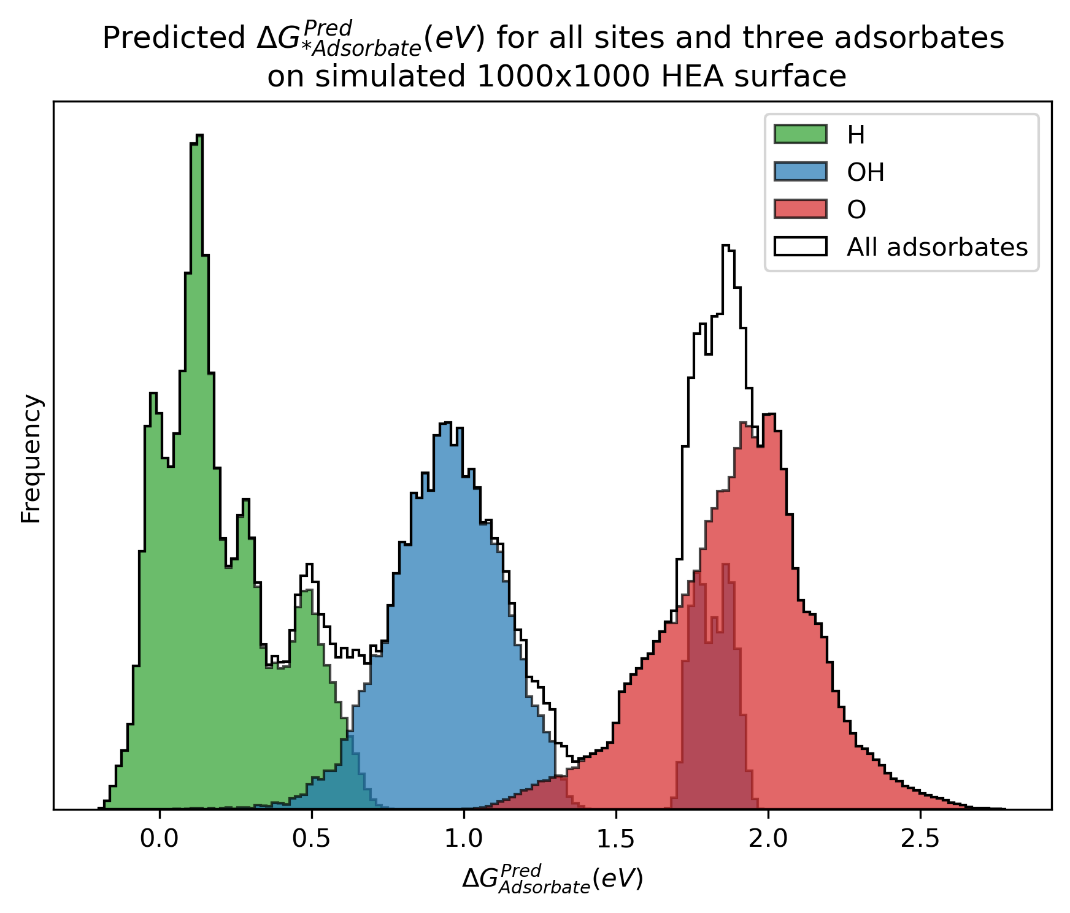
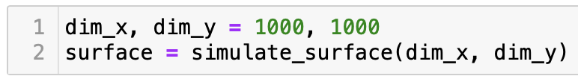
Week 5+6: Surfaces -> Energies -> CVs
XGBoost model for on-top sites
XGBoost model for hollow sites

Slide 9
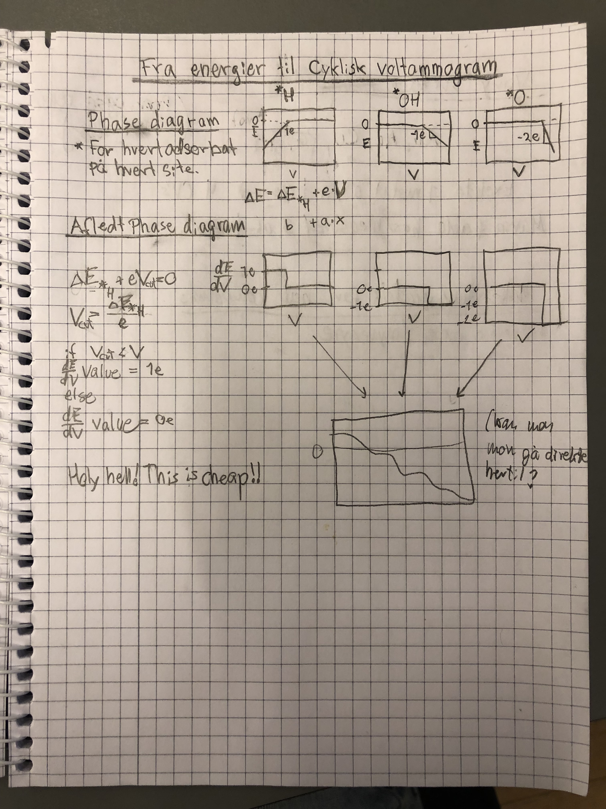
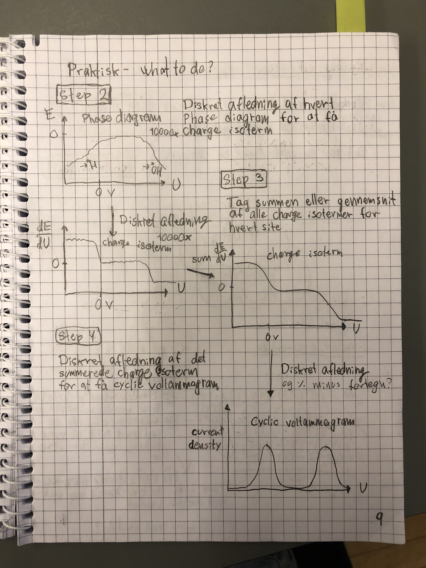
Week 5+6: Surfaces -> Energies -> CVs
Notes:
Next up:
Vary surface composition
Make CV
What impact does the surface composition have on the CV?
Optimize j based on surface composition
Is there a way to automate the search perhaps?

Slide 10
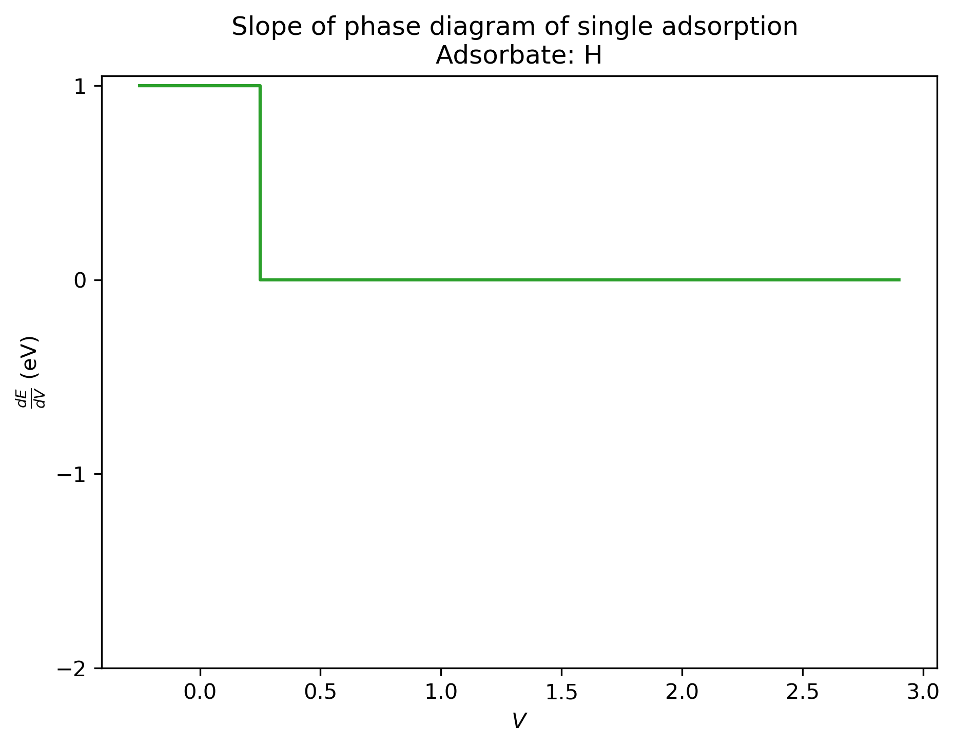
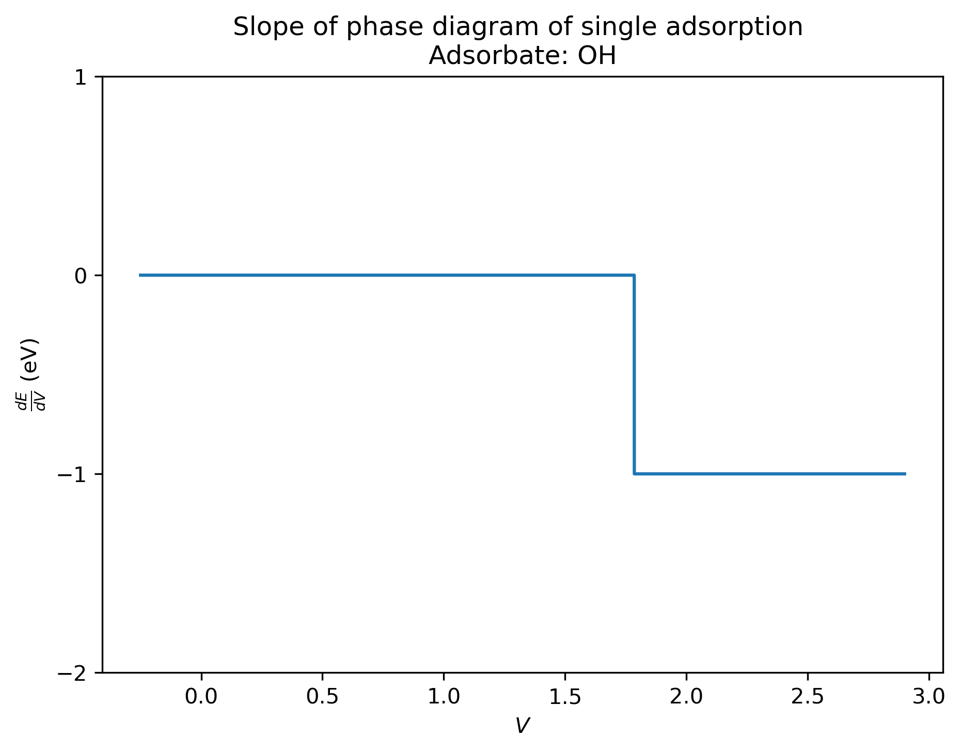
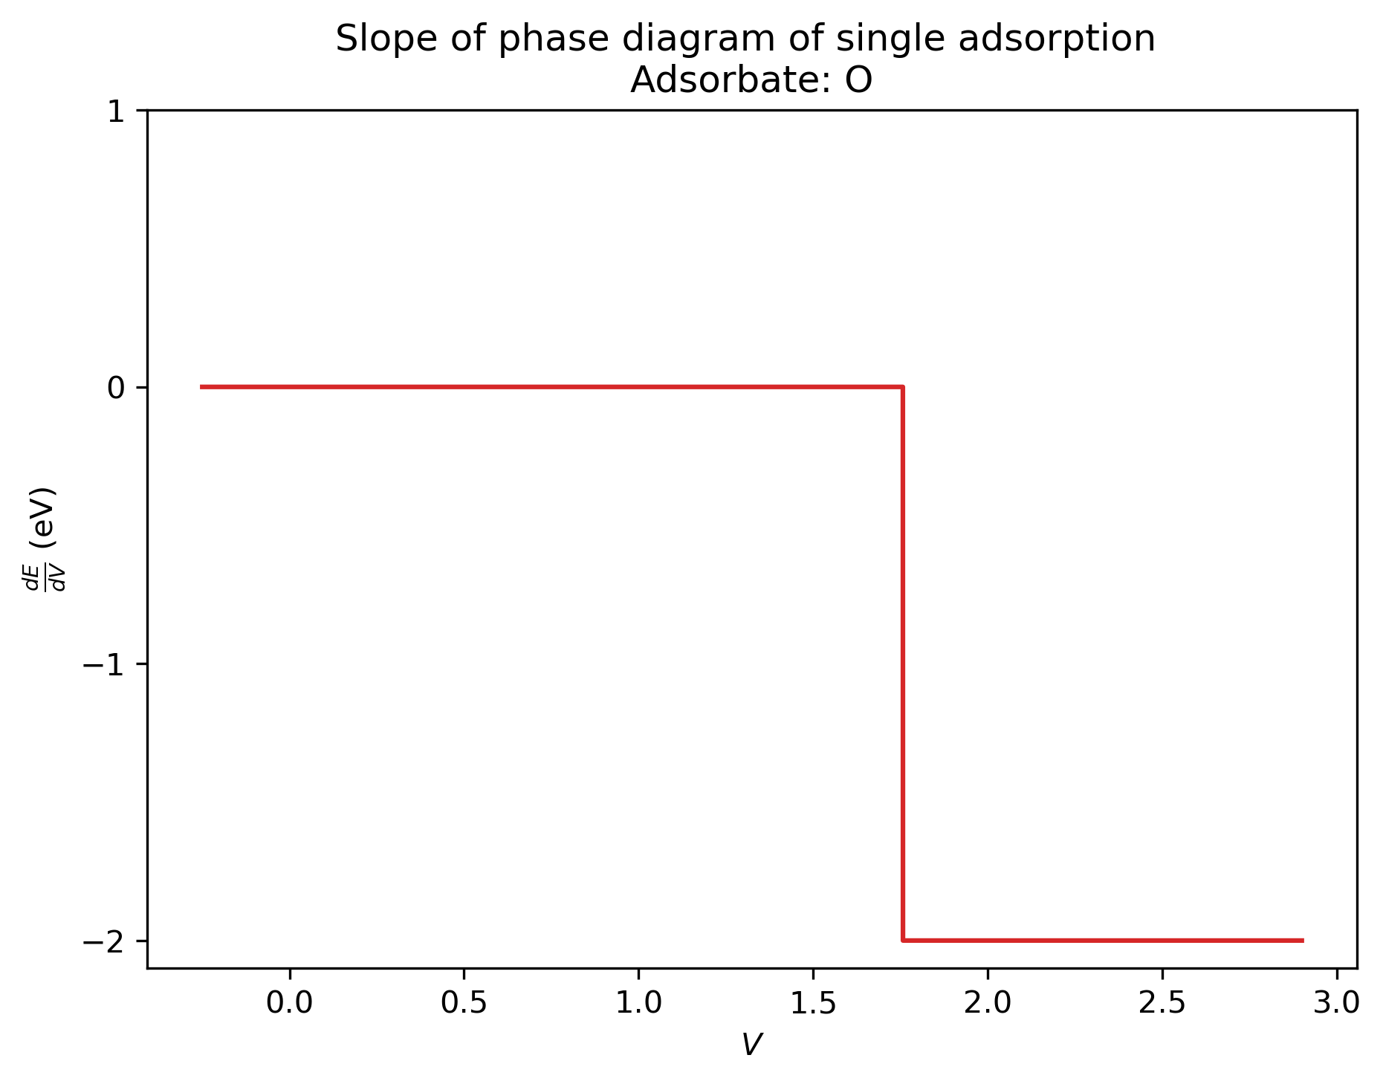
Energies -> CVs

Slide 11
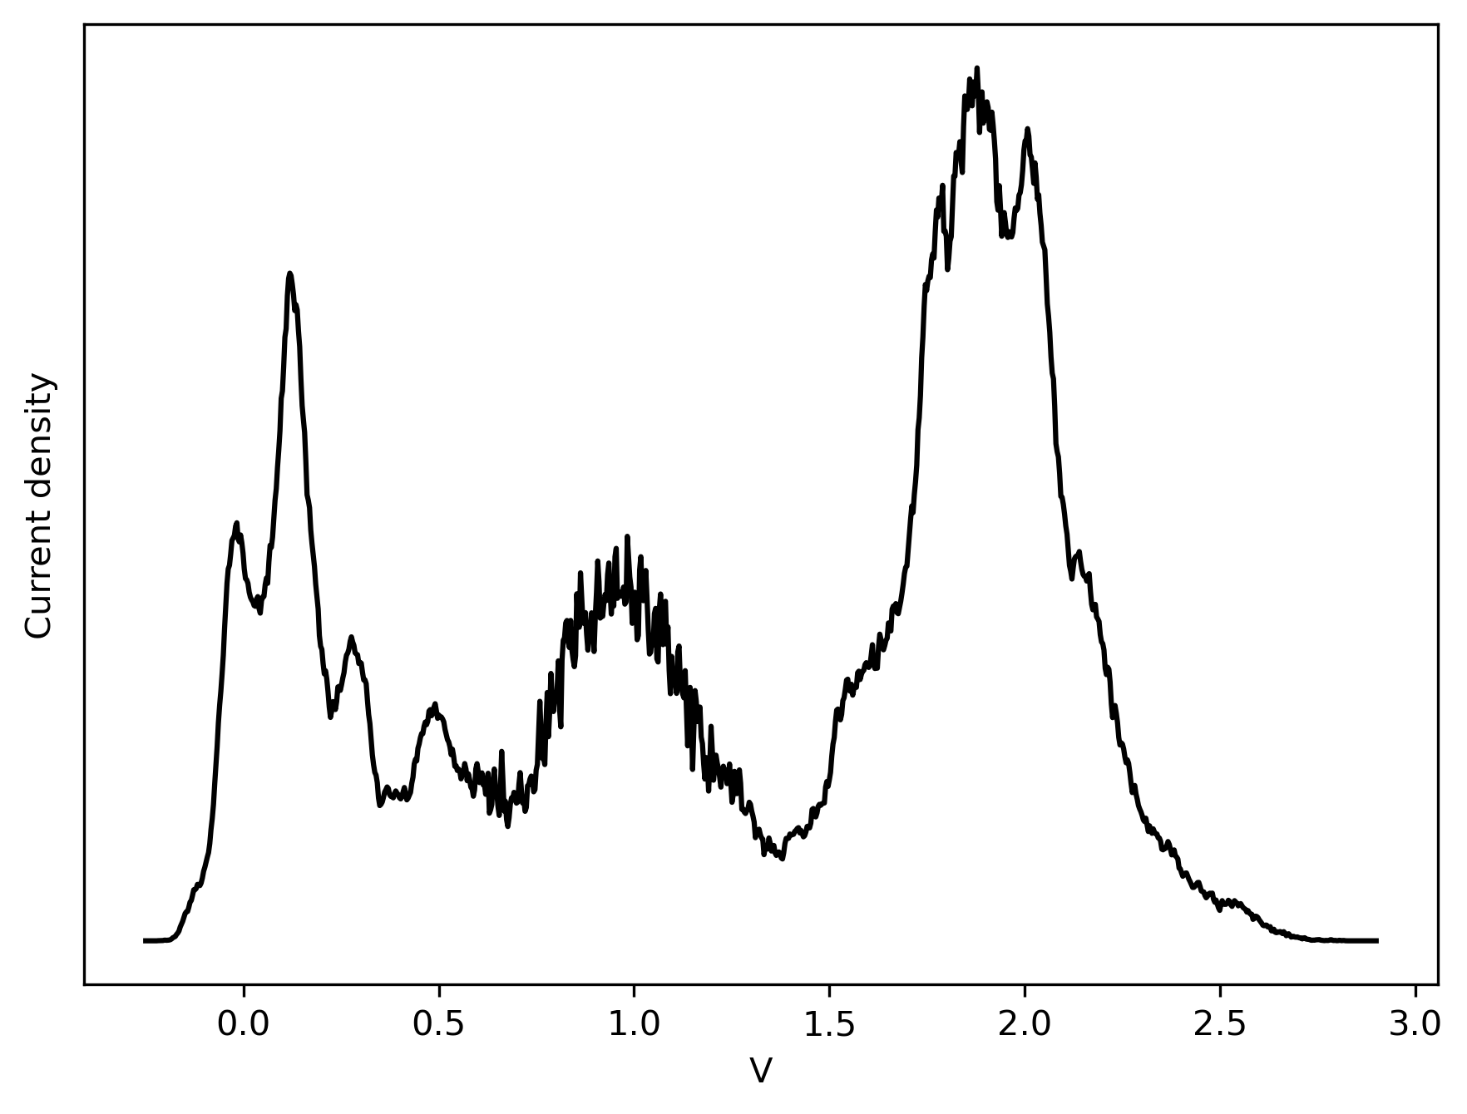
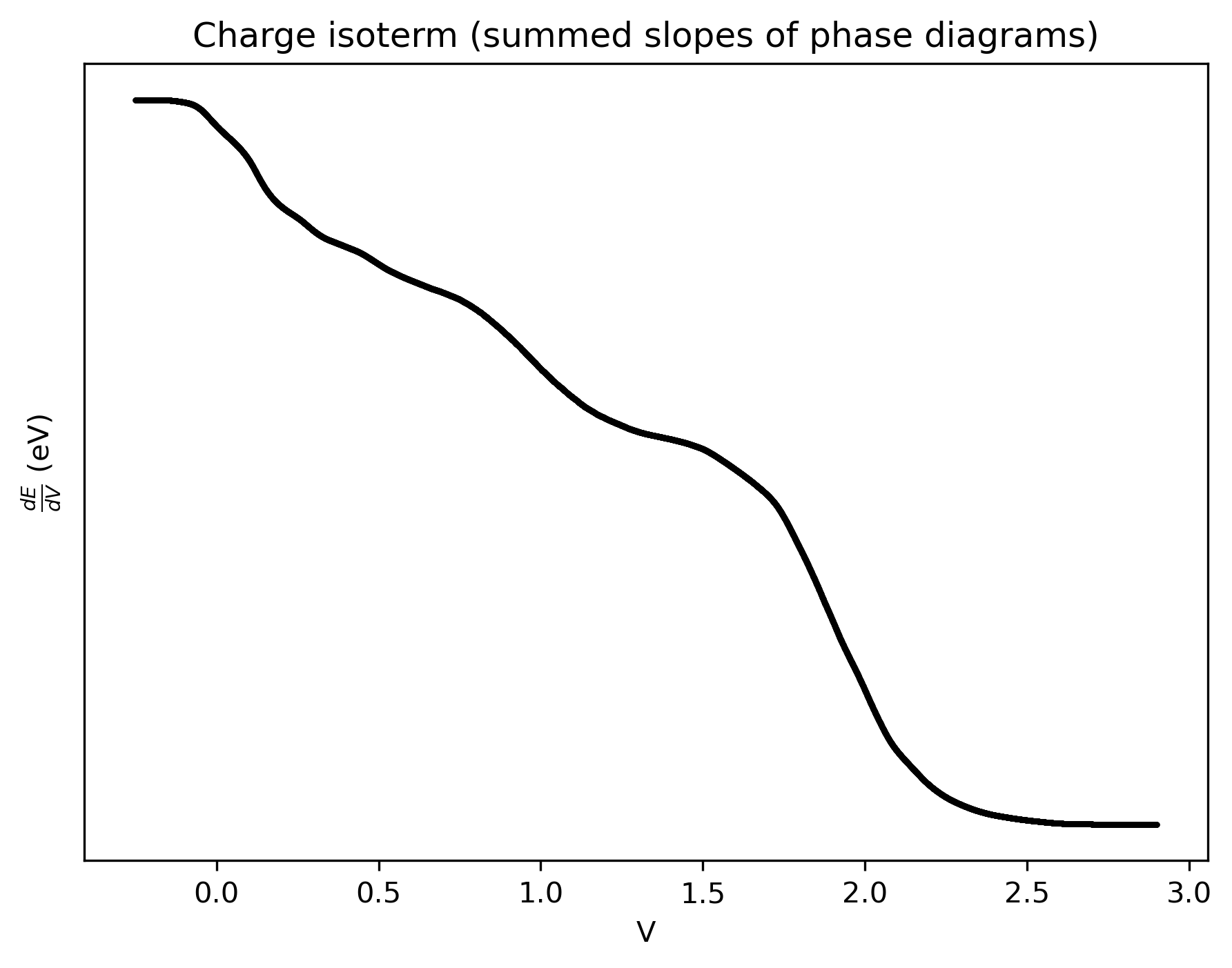
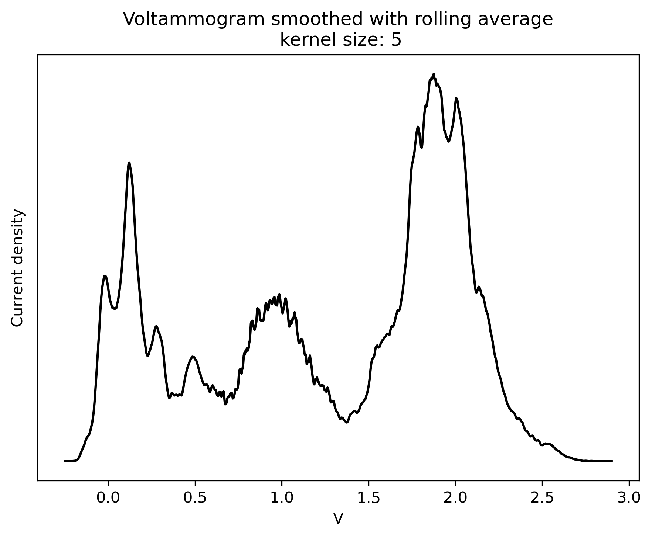
Energies -> CVs
1 Million of each
Sum
Afledning

Slide 12
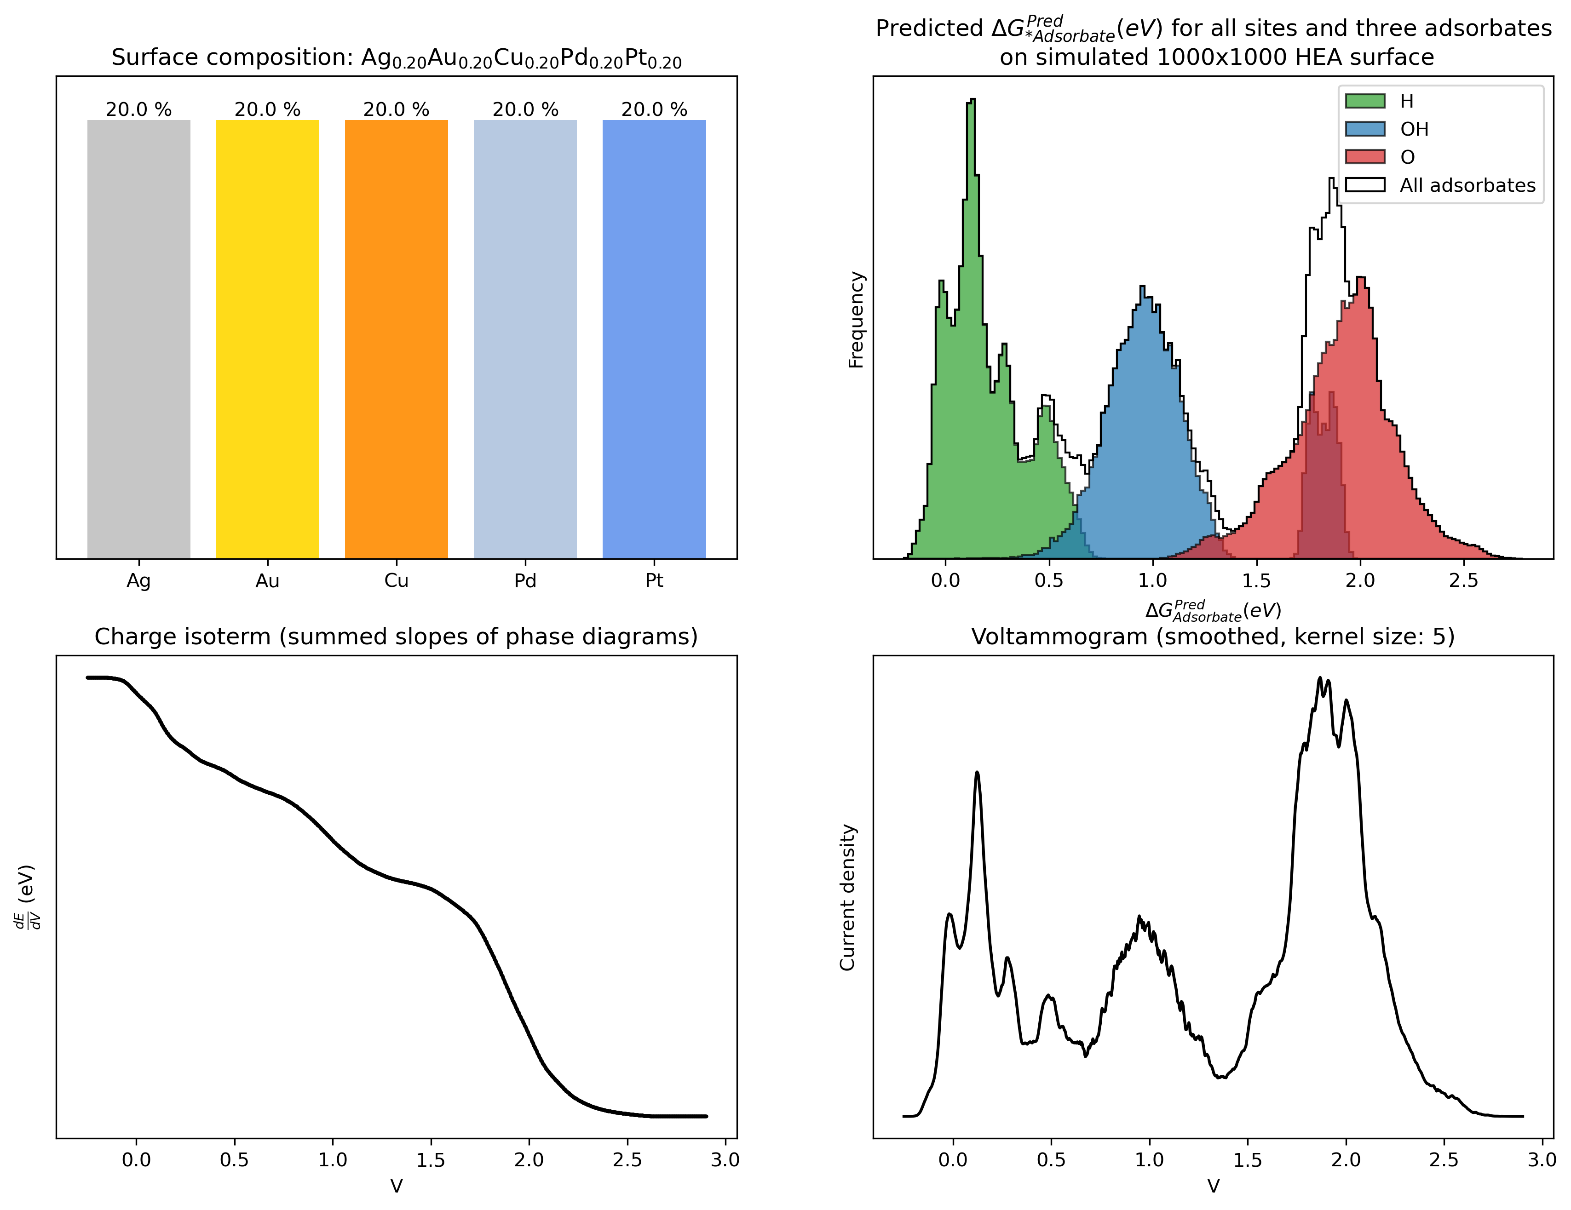
Automatic procedure: Surface -> Voltammogram
Surface
Composition: Even split between all metals
Size: 1000x1000 surface
Runtime: 6 minutes

Slide 13
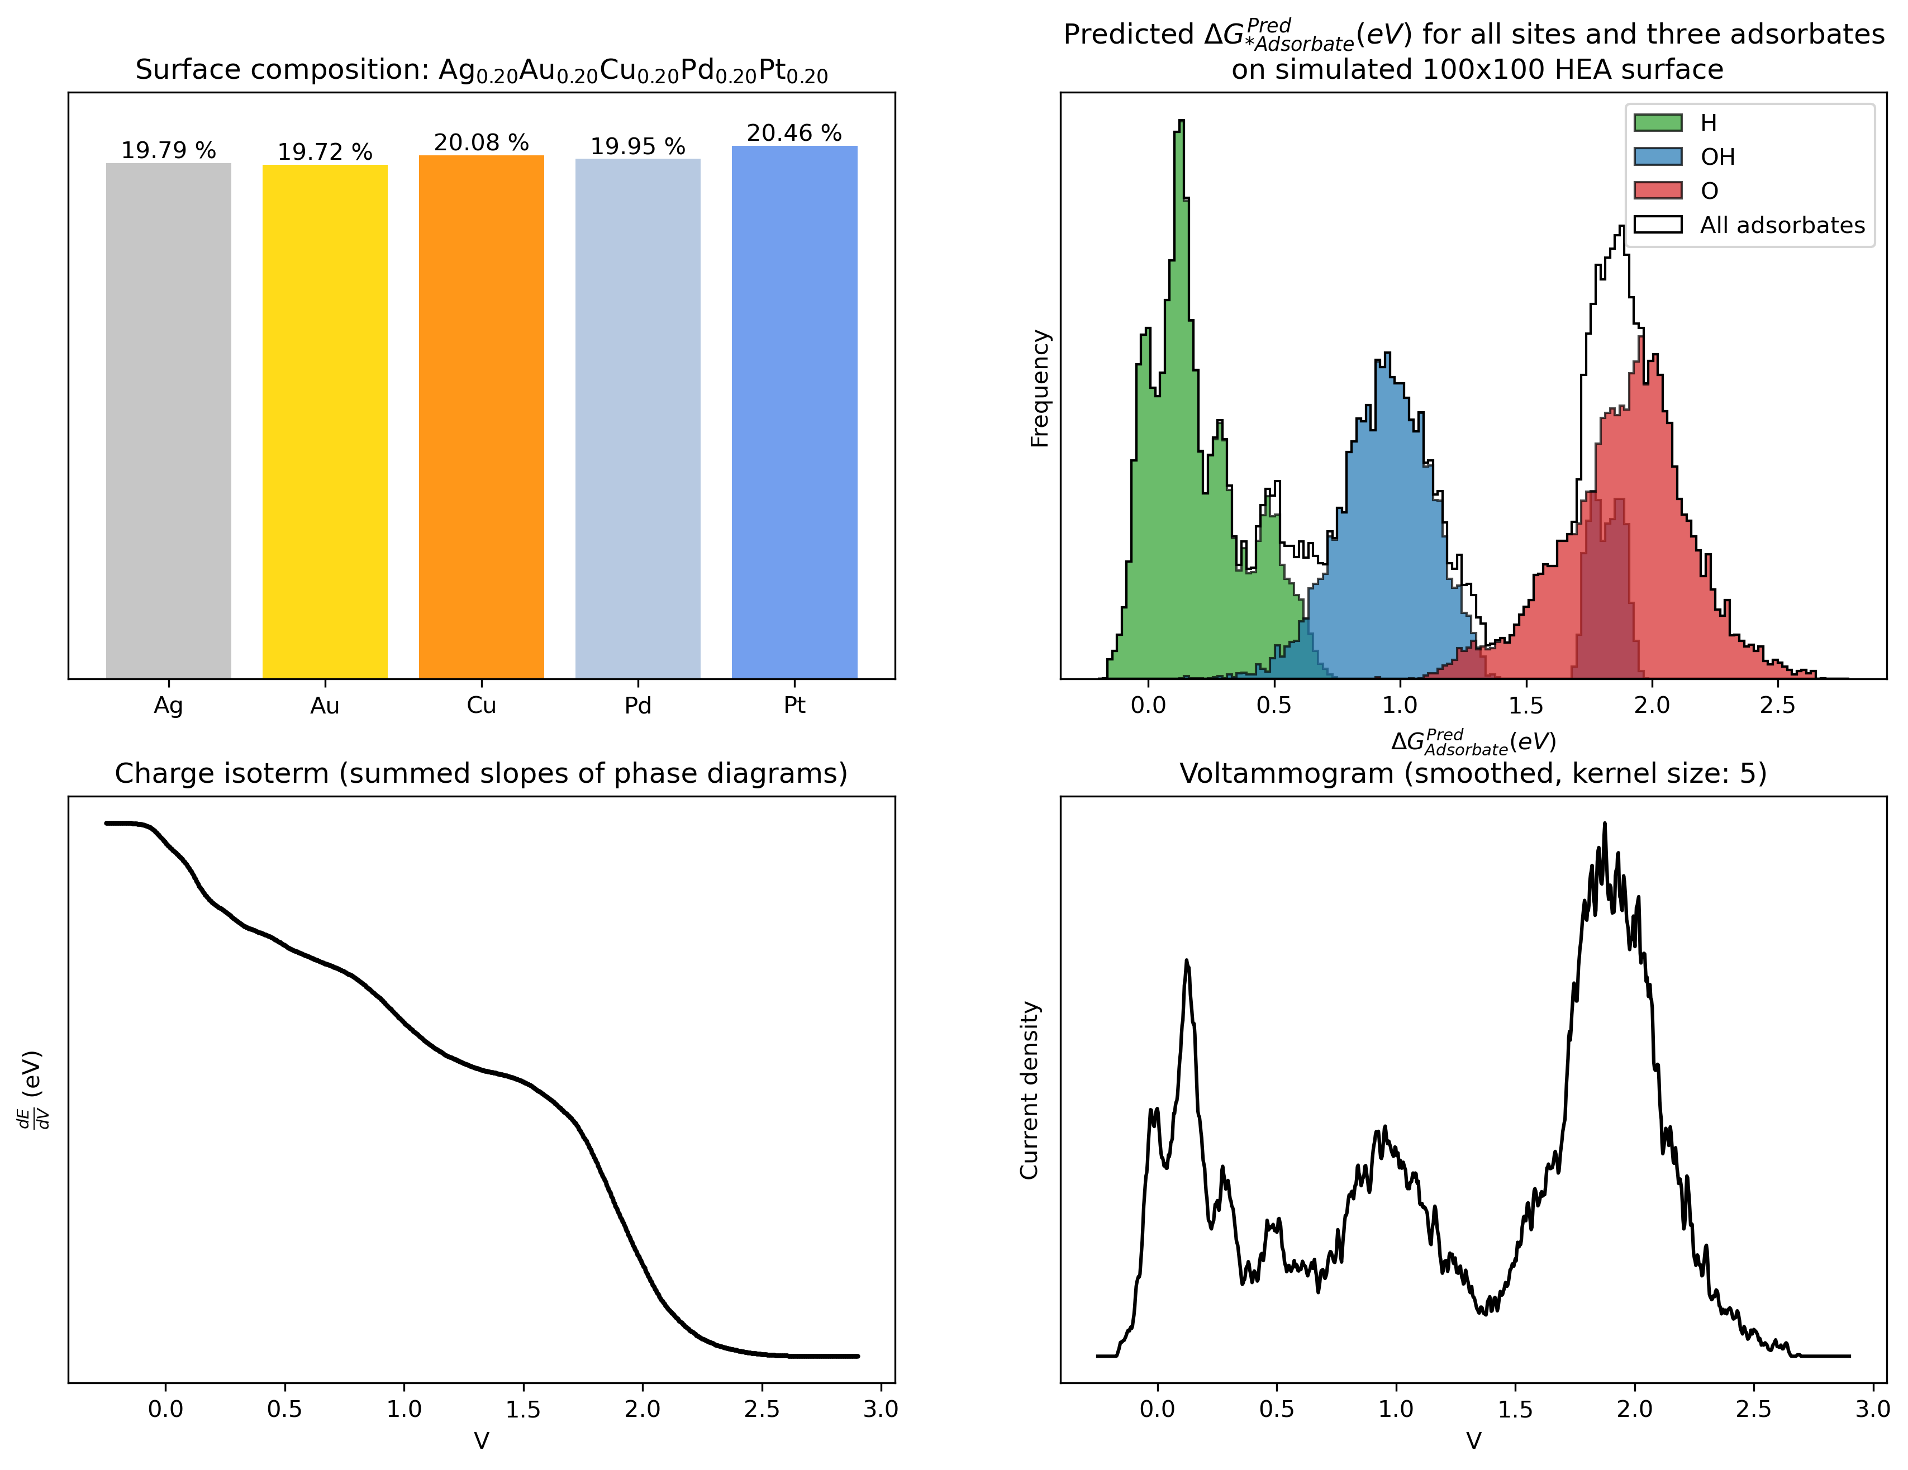
Automatic procedure: Surface -> Voltammogram
Surface
Composition: Even split between all metals, but randomly drawn
Size: 100x100 surface
Runtime: 3.5 seconds

Slide 14
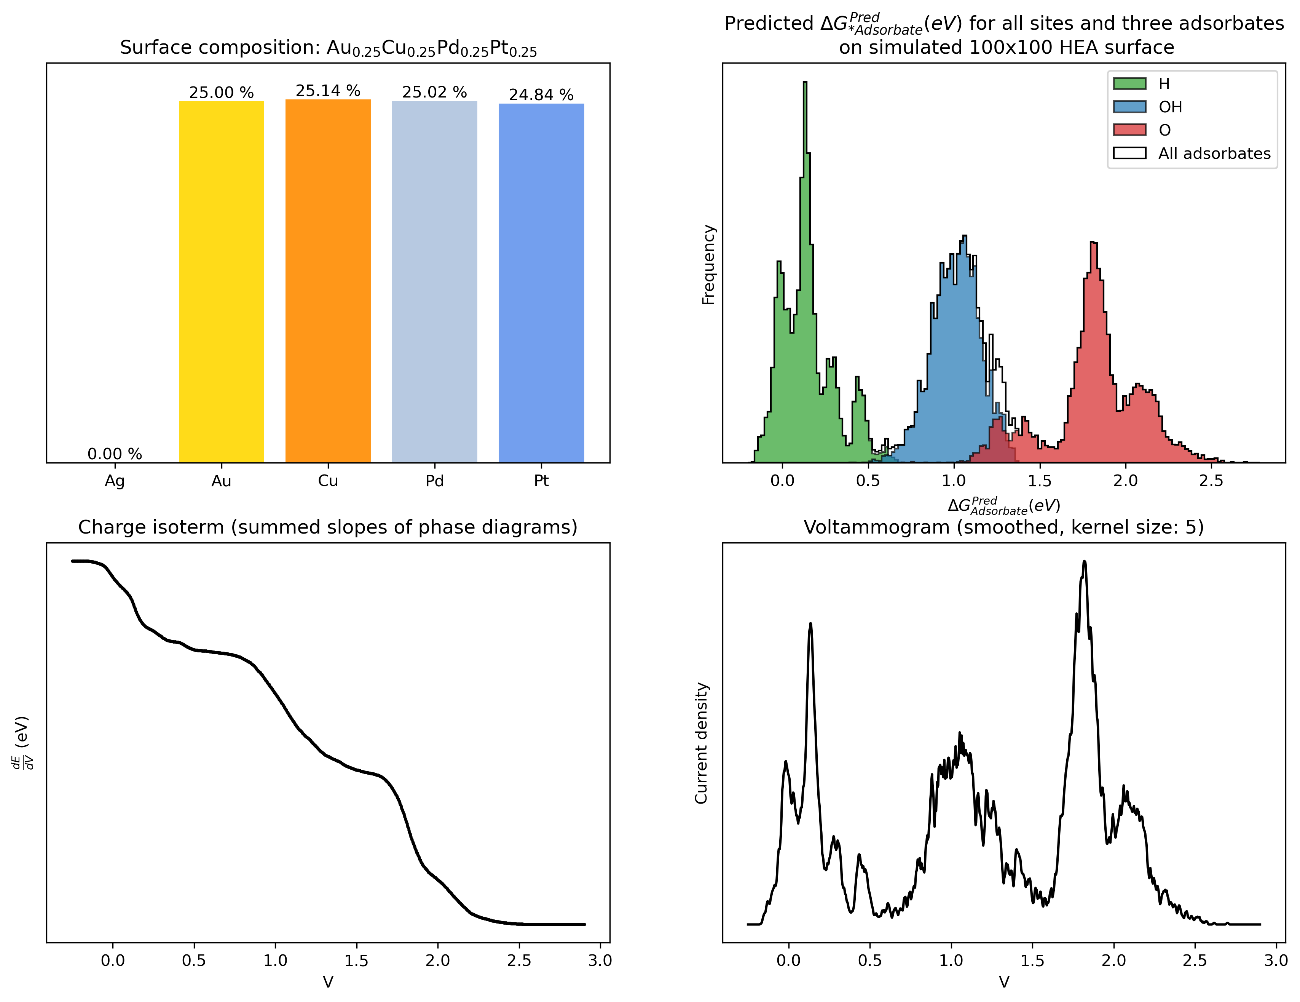
Automatic procedure: Surface -> Voltammogram
Surface
Composition: Excluding one of the metals, randomly drawn
Size: 100x100 surface
Runtime: 3.5 seconds

Slide 15
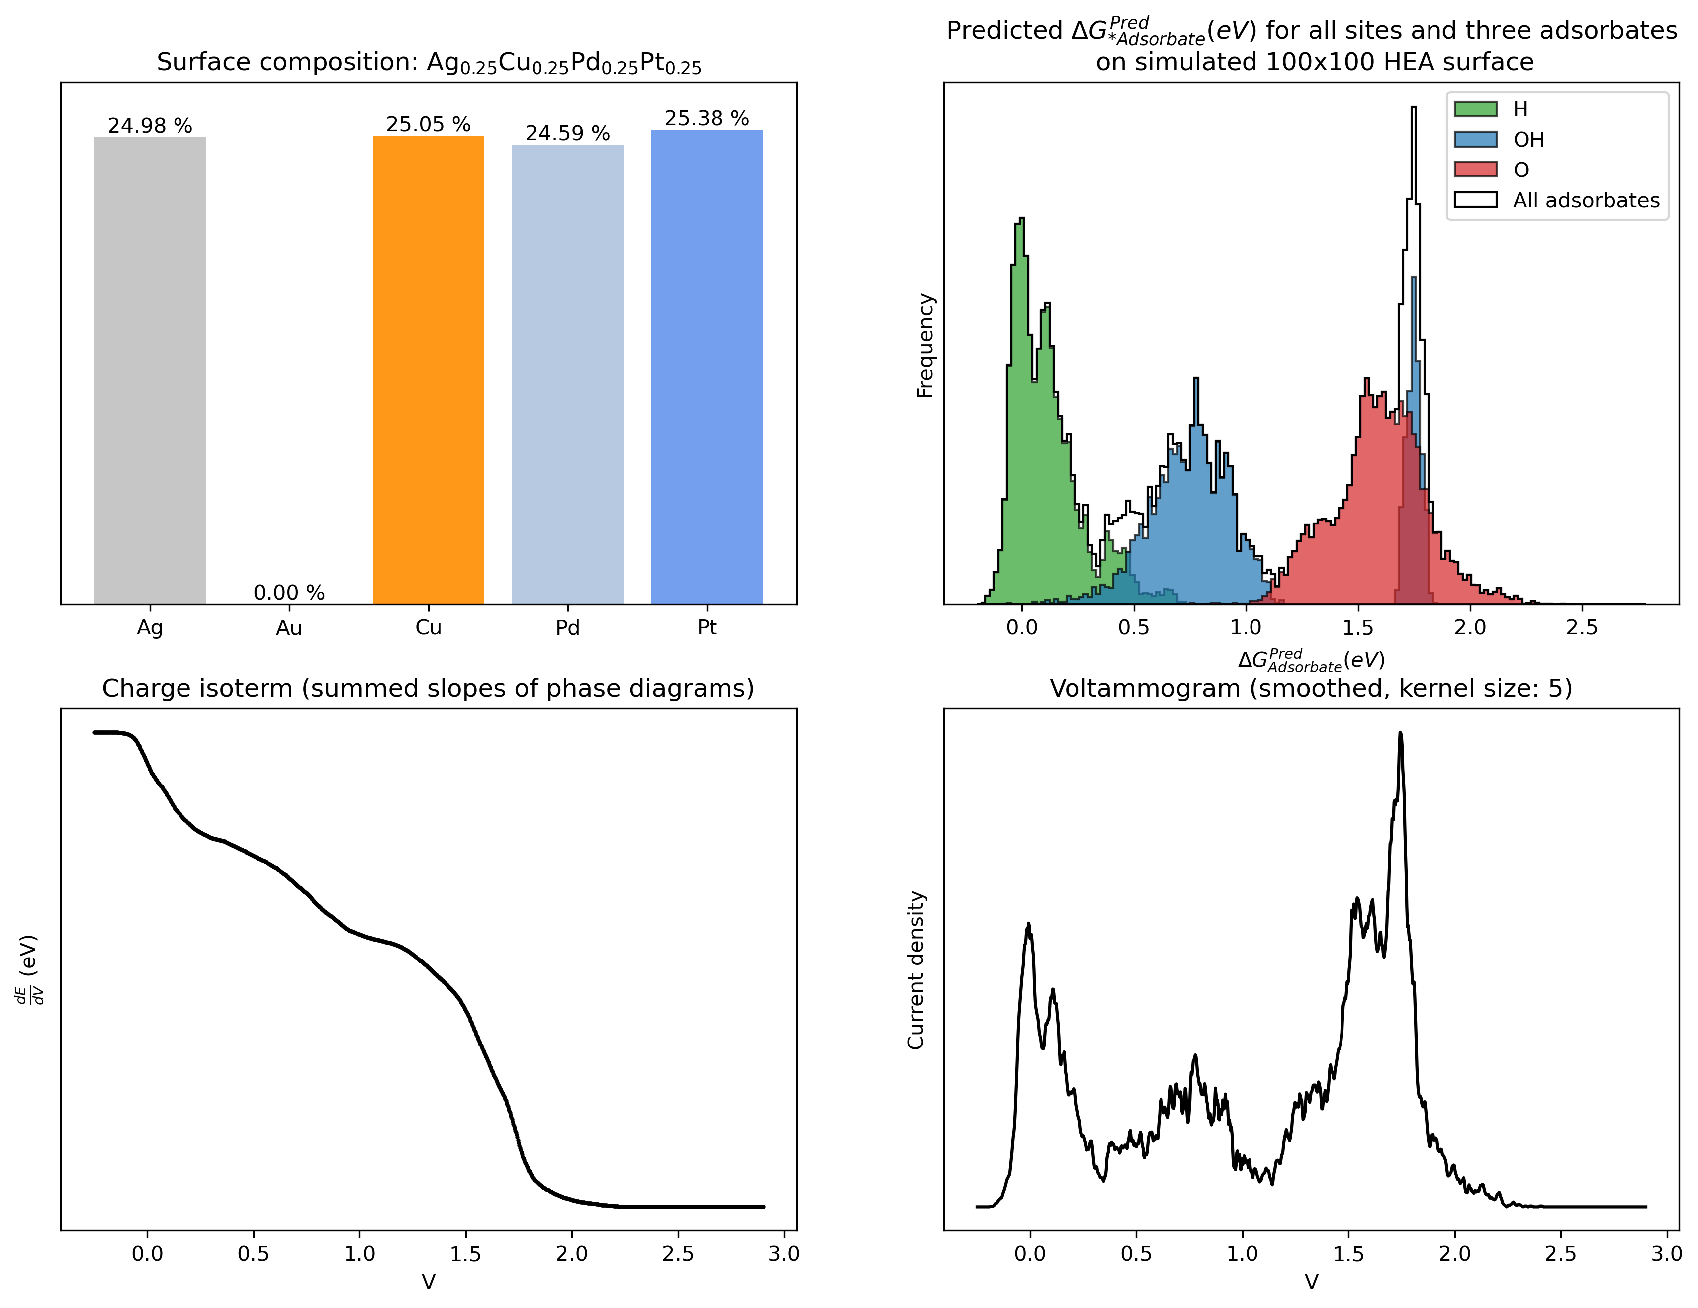
Automatic procedure: Surface -> Voltammogram
Surface
Composition: Excluding one of the metals, randomly drawn
Size: 100x100 surface
Runtime: 3.5 seconds

Slide 16
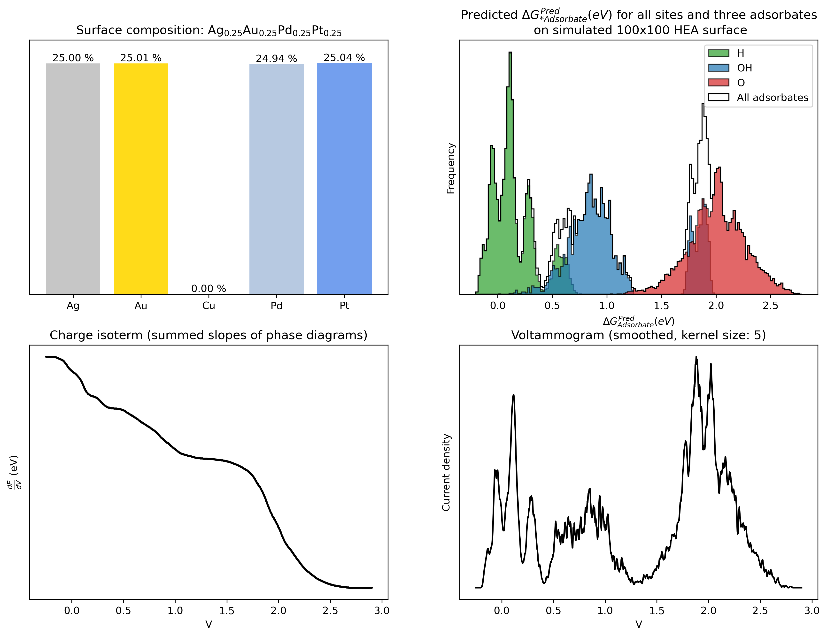
Automatic procedure: Surface -> Voltammogram
Surface
Composition: Excluding one of the metals, randomly drawn
Size: 100x100 surface
Runtime: 3.5 seconds

Slide 17
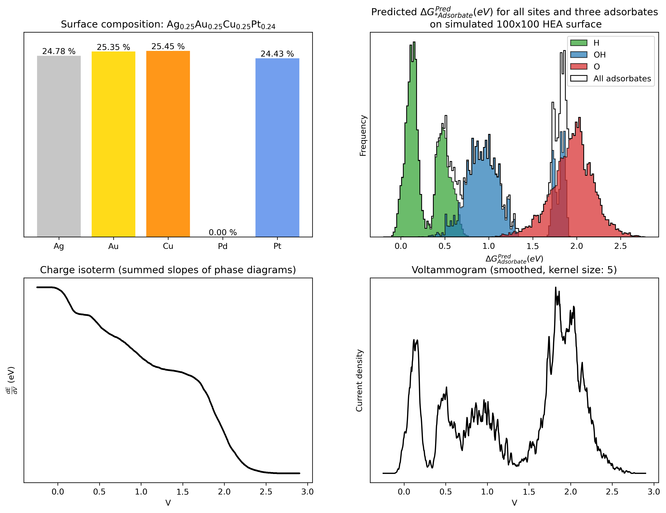
Automatic procedure: Surface -> Voltammogram
Surface
Composition: Excluding one of the metals, randomly drawn
Size: 100x100 surface
Runtime: 3.5 seconds

Slide 18
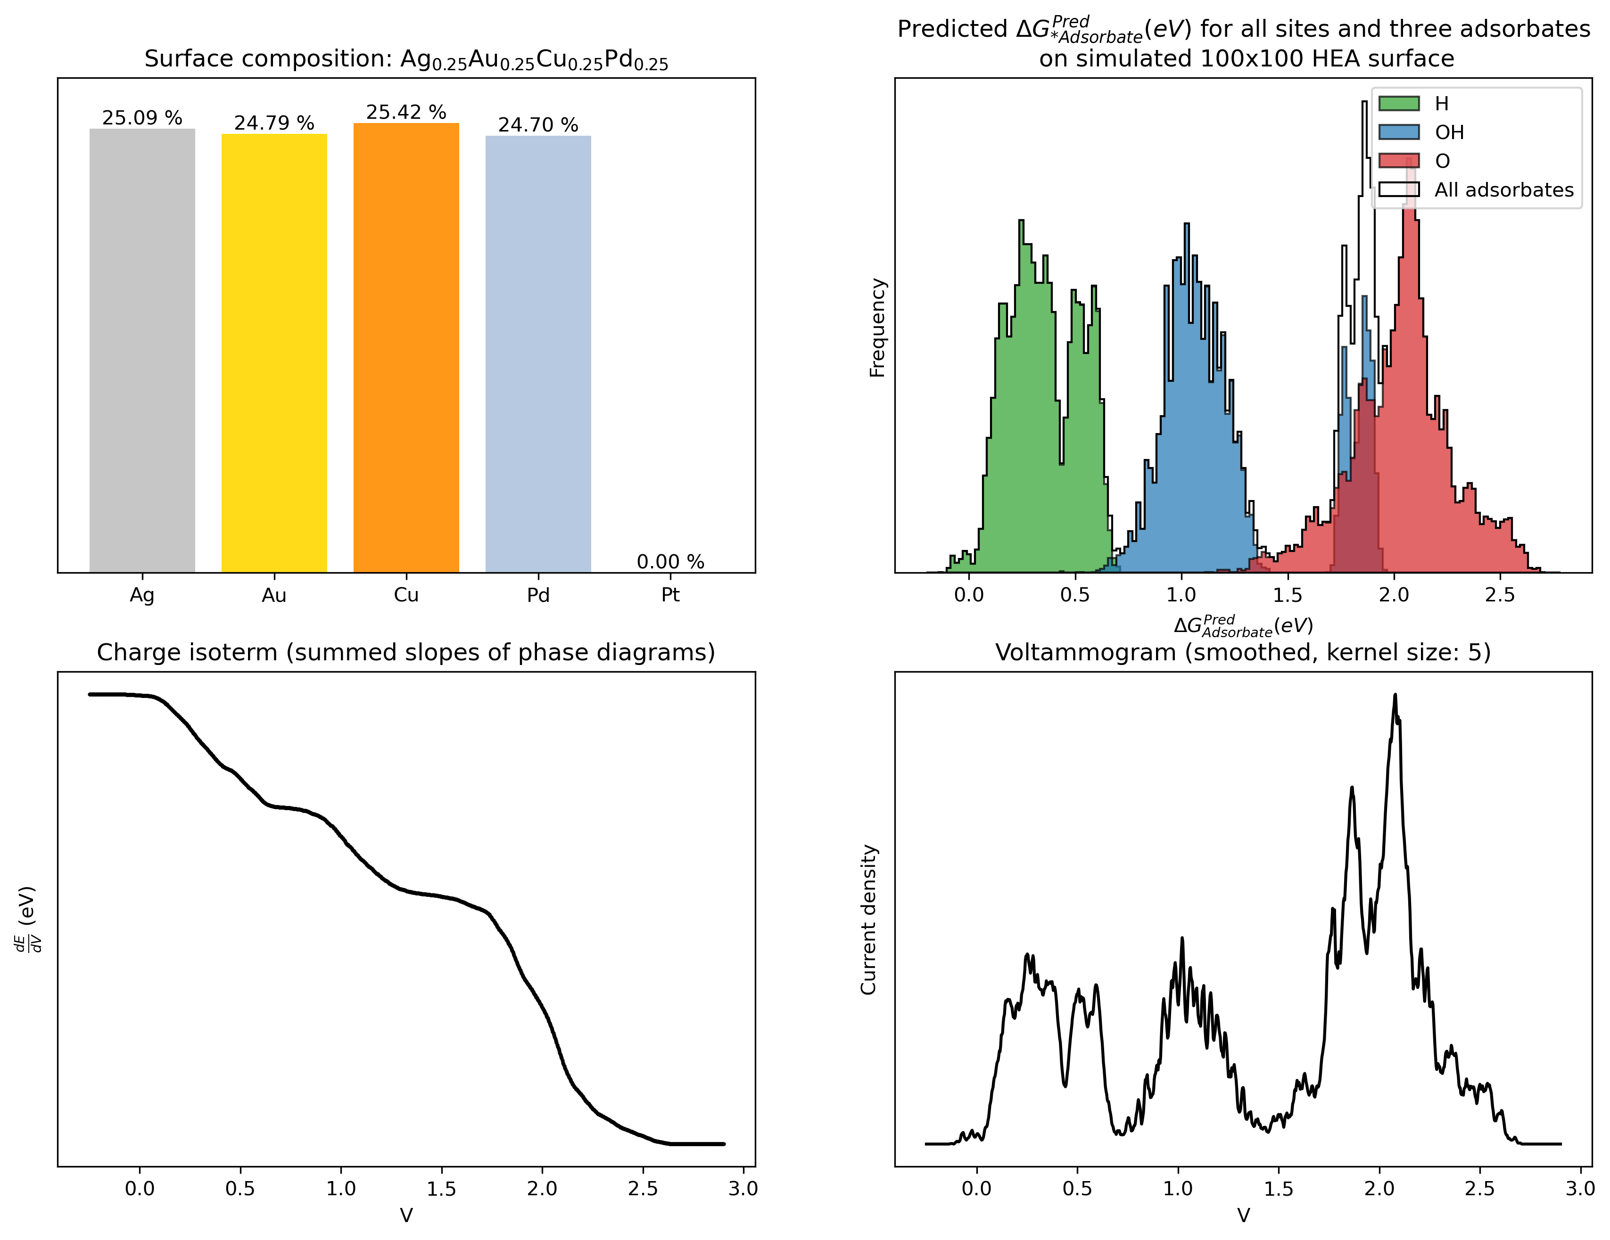
Automatic procedure: Surface -> Voltammogram
Surface
Composition: Excluding one of the metals, randomly drawn
Size: 100x100 surface
Runtime: 3.5 seconds

Slide 19
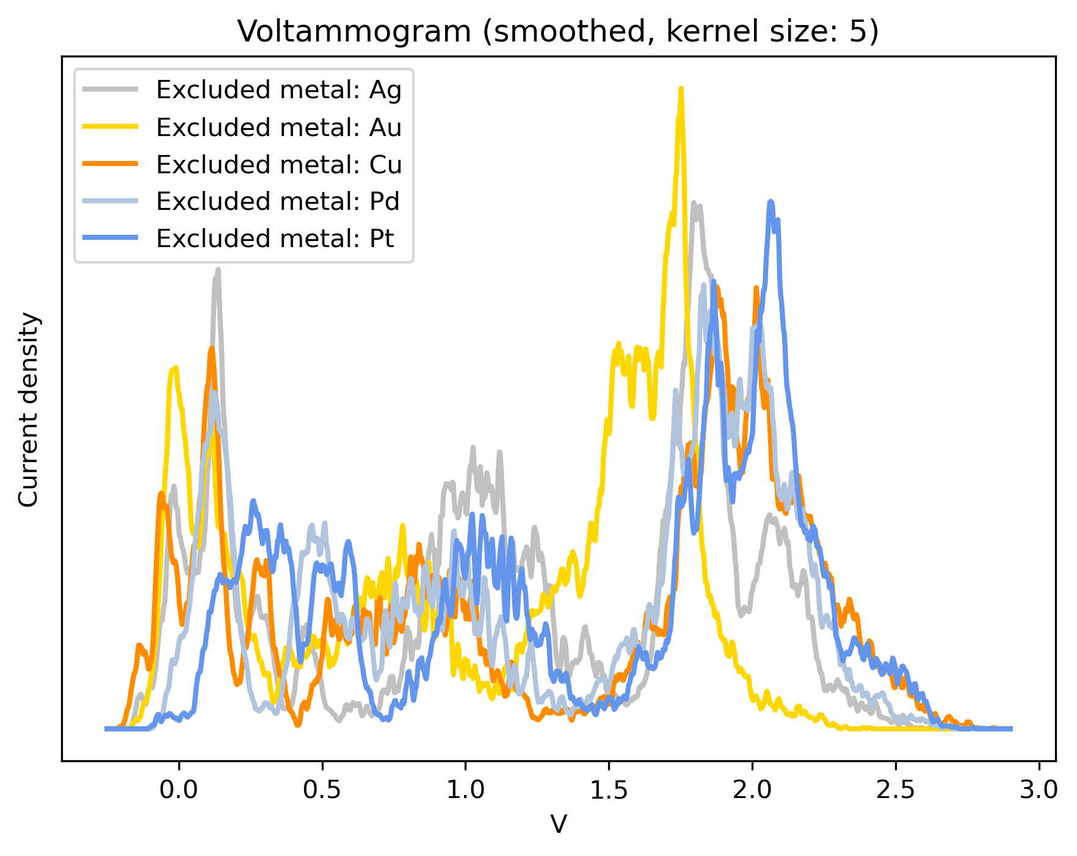
Automatic procedure: Surface -> Voltammogram
Surfaces
Composition: Excluding one of the metals, randomly drawn
Size: 100x100 surface
Runtime: 3.5 seconds

Slide 20
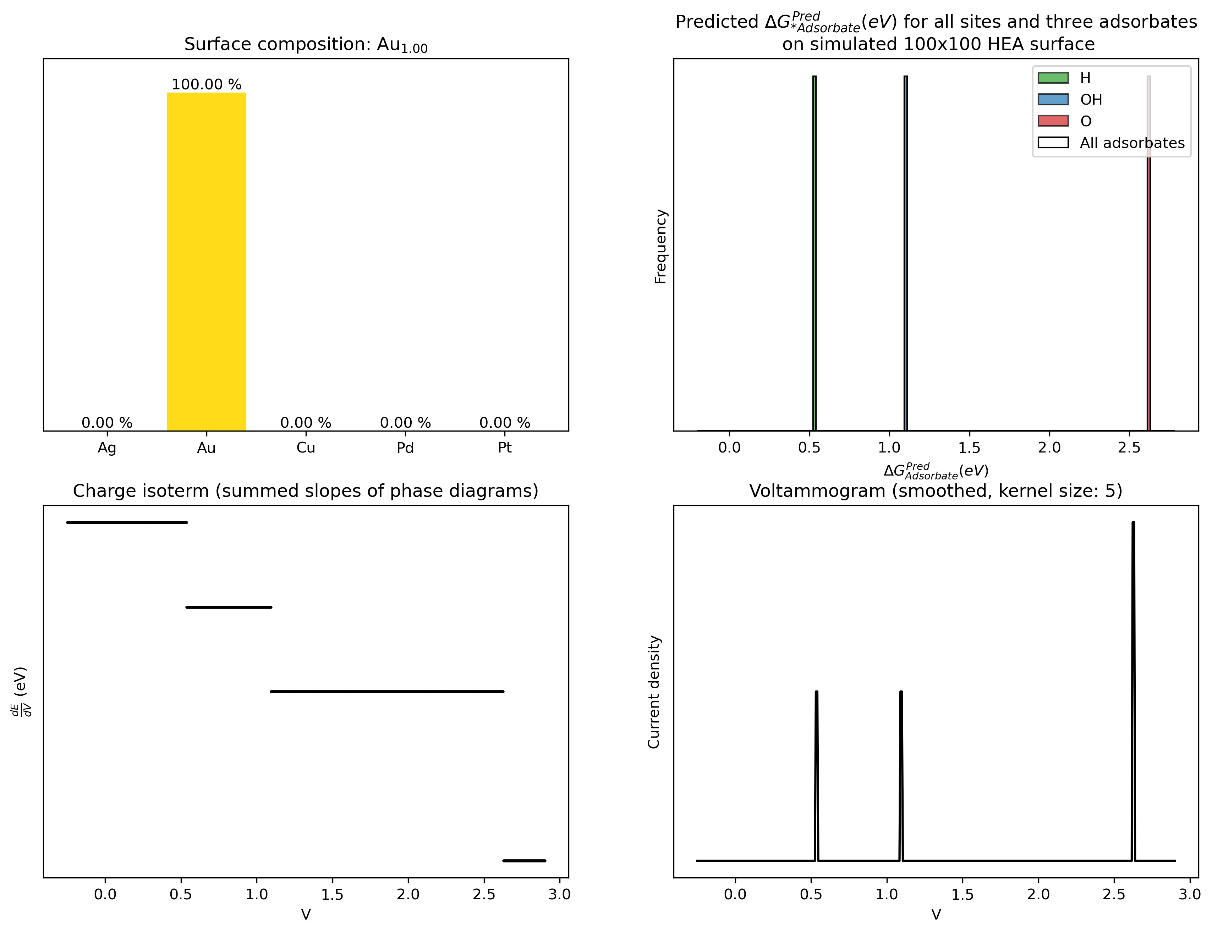
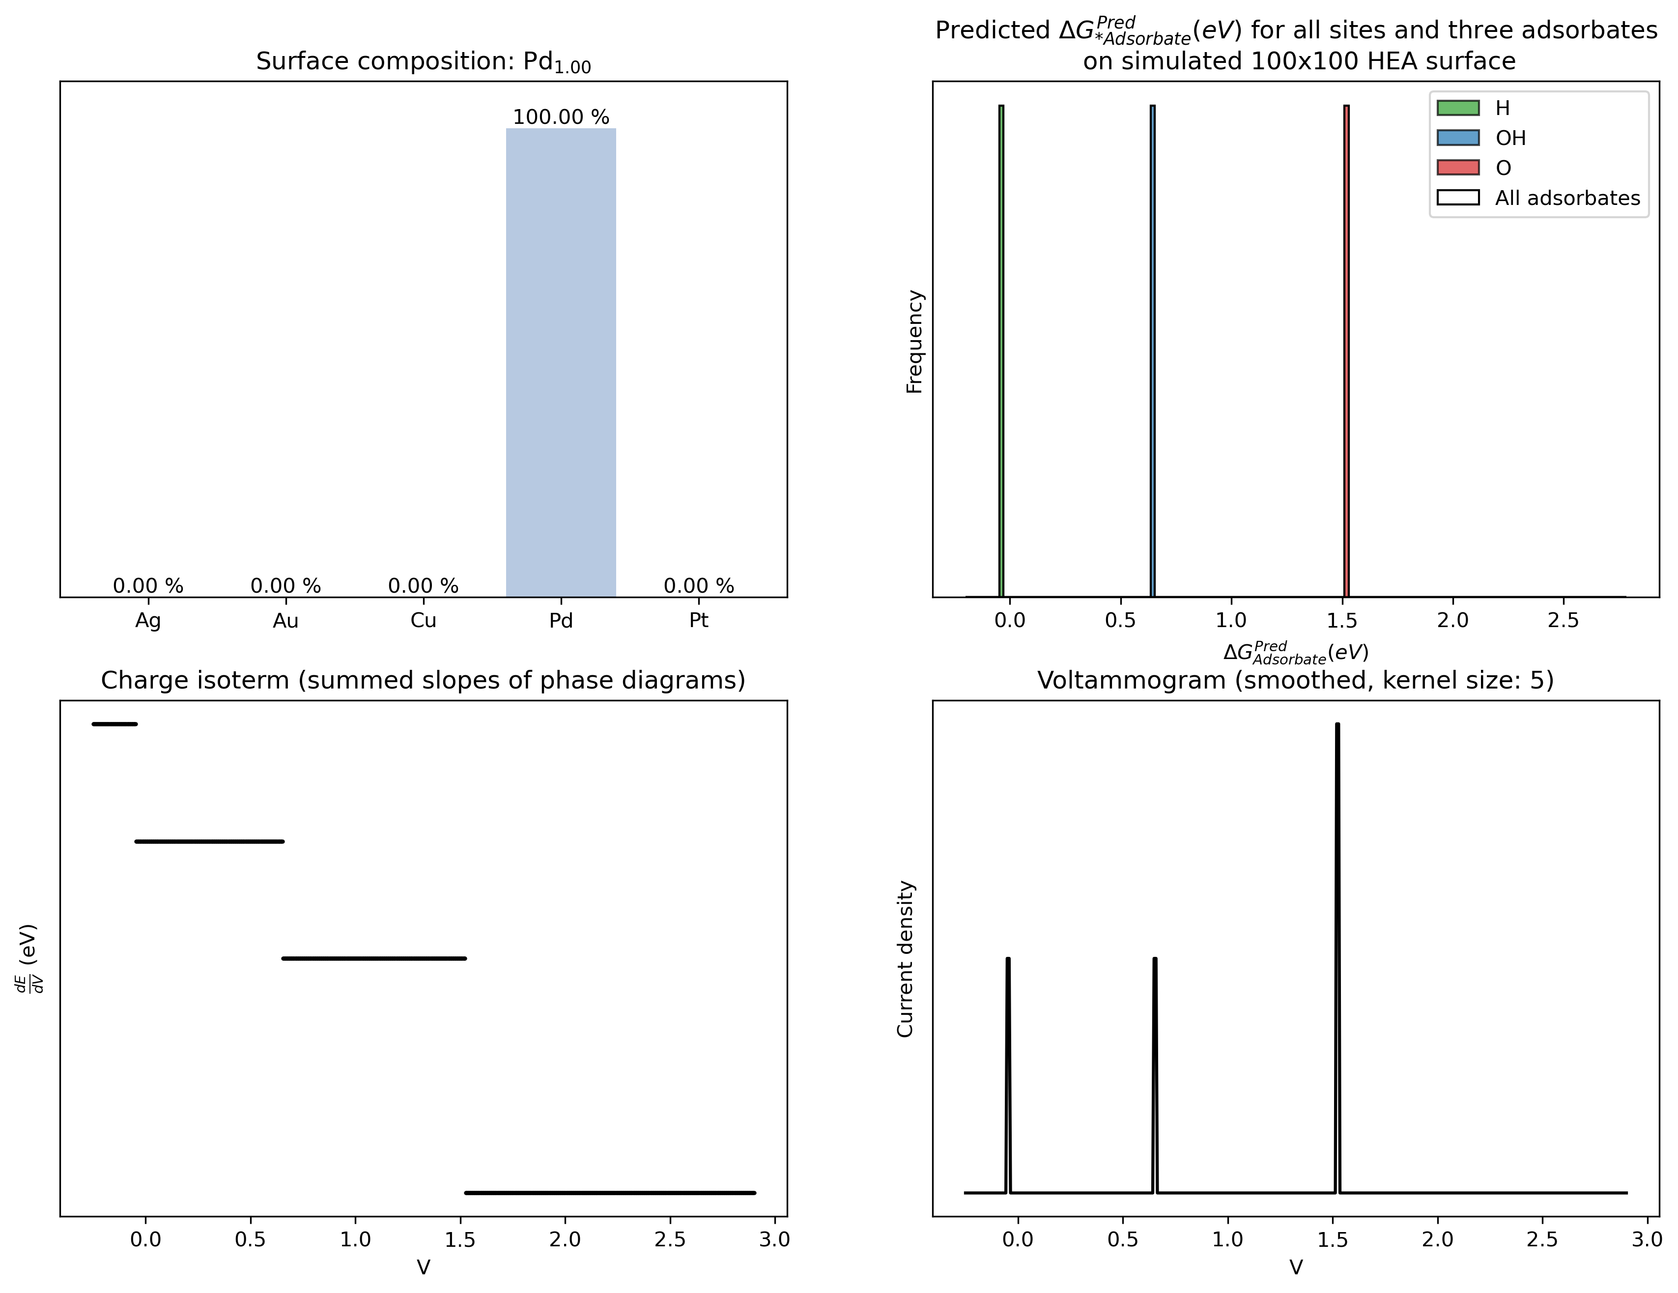
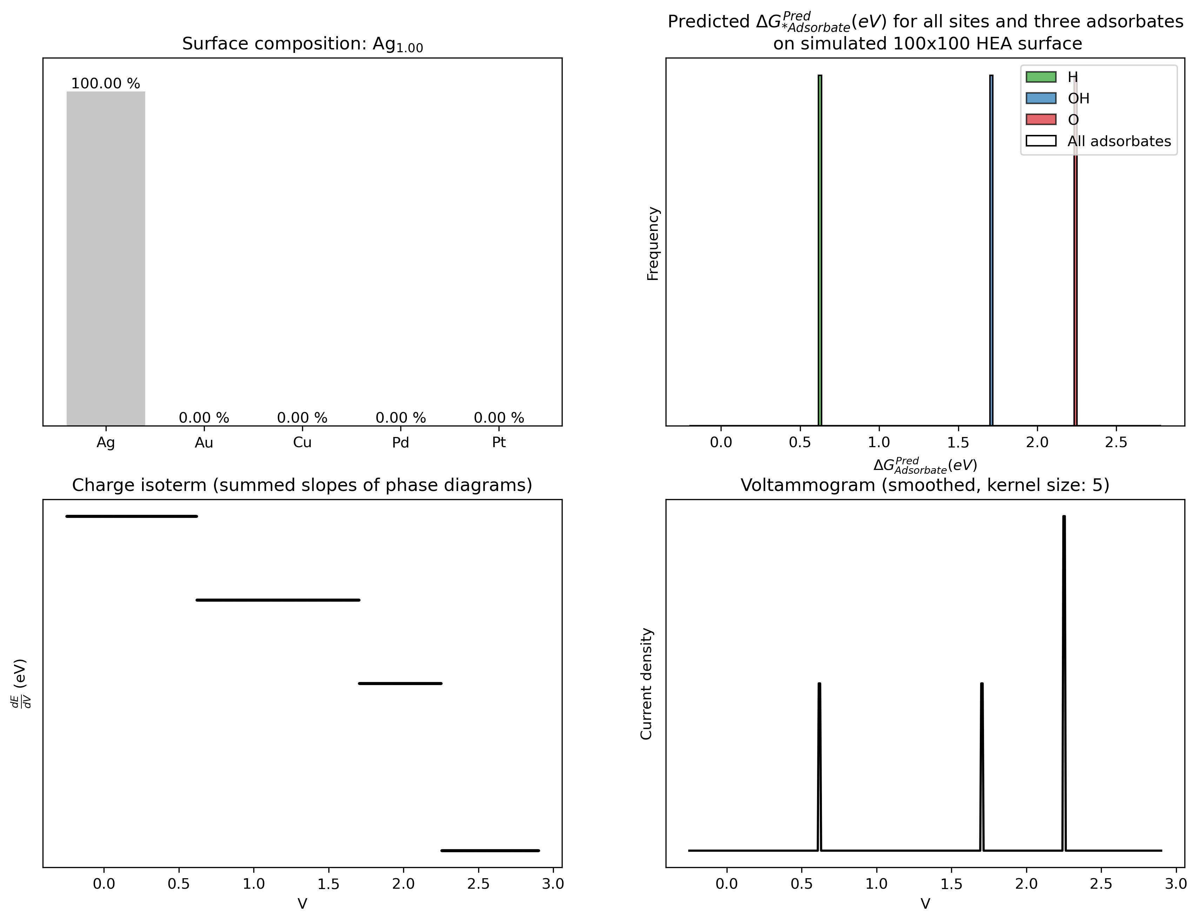
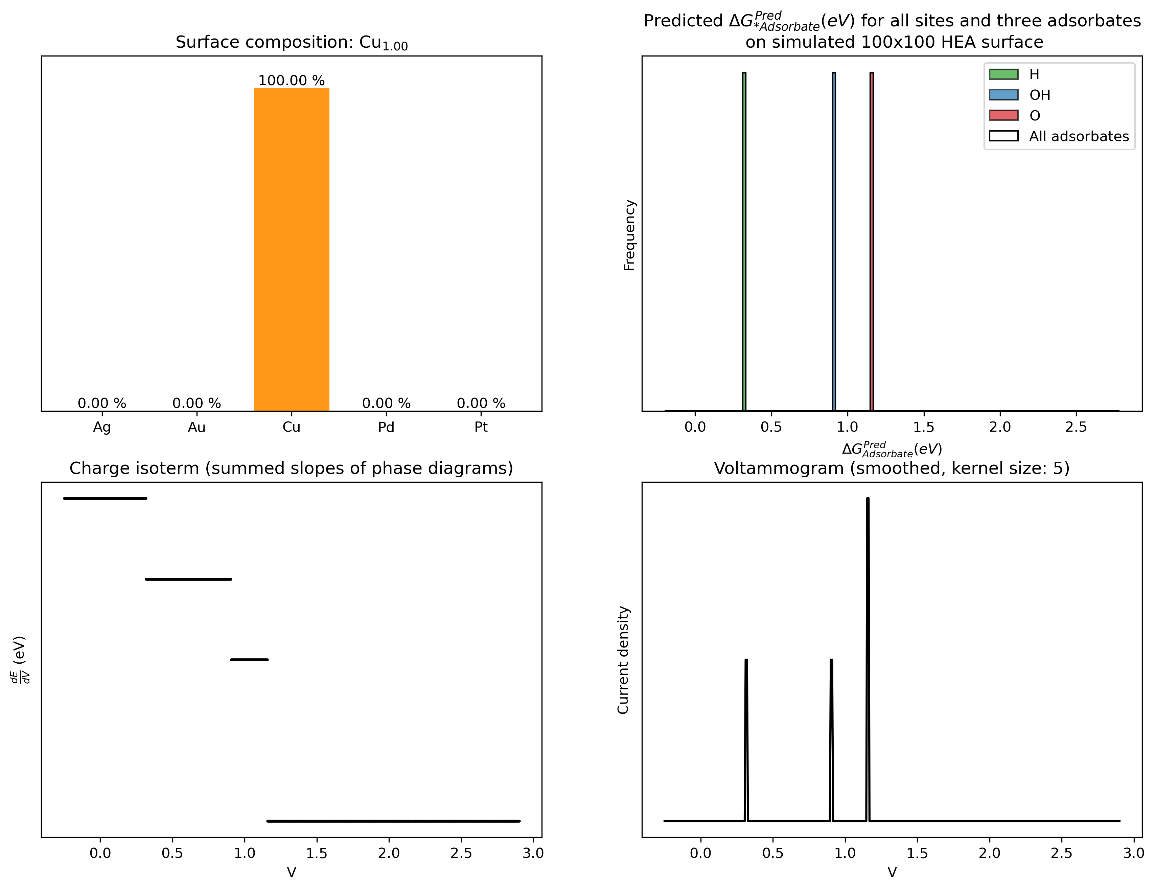
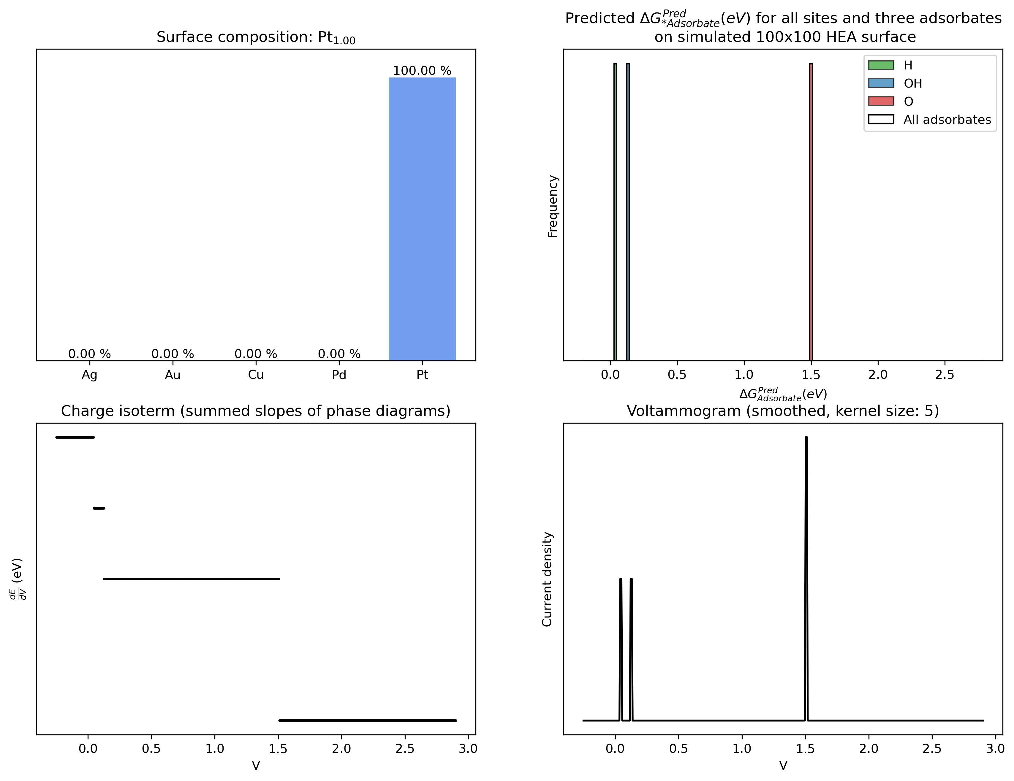
Automatic procedure: Surface -> Voltammogram
Surface
Composition: Including one of the metals, randomly drawn
Size: 100x100 surface
Runtime: 3.5 seconds

Slide 21
Automatic procedure: Surface -> Voltammogram
Some factors can not be modeled by this approach
Hysteresis
Steric hindrance

Slide 22
Simulating adsorbtion while varying voltage
New approach:
New surface (clean)
Set voltage
Predict Delta G for all possible adsorbates
Account for voltage
Add bonus energy from steric hindrance for each neighbour
Adsorb adsorbates with Delta G < 0
Remove adsorbates with Delta G > Hysteresis energy barrier

Slide 23
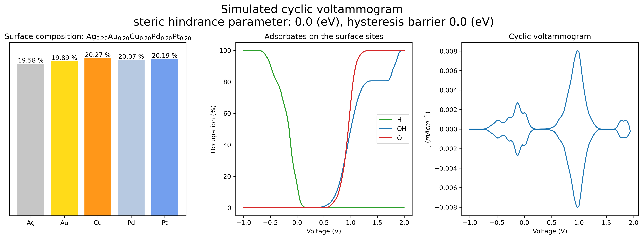
Simulating adsorbtion while varying voltage

Slide 24
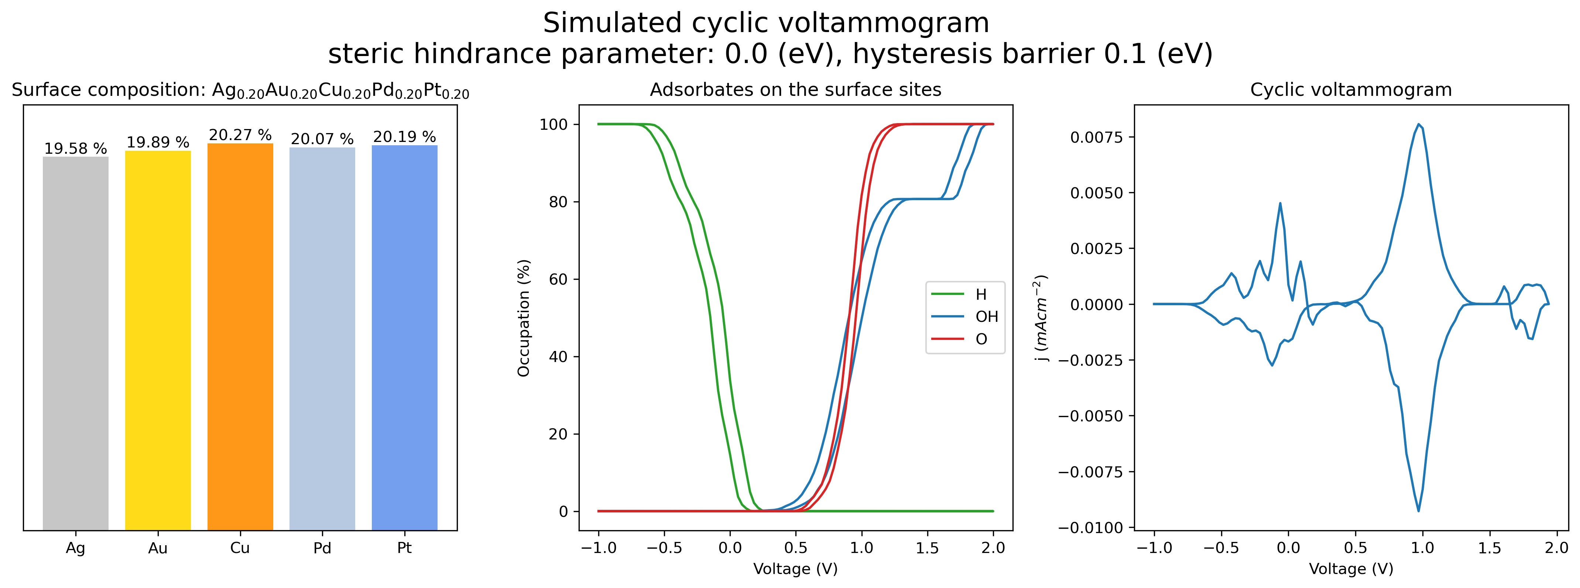
Simulating adsorbtion while varying voltage

Slide 25
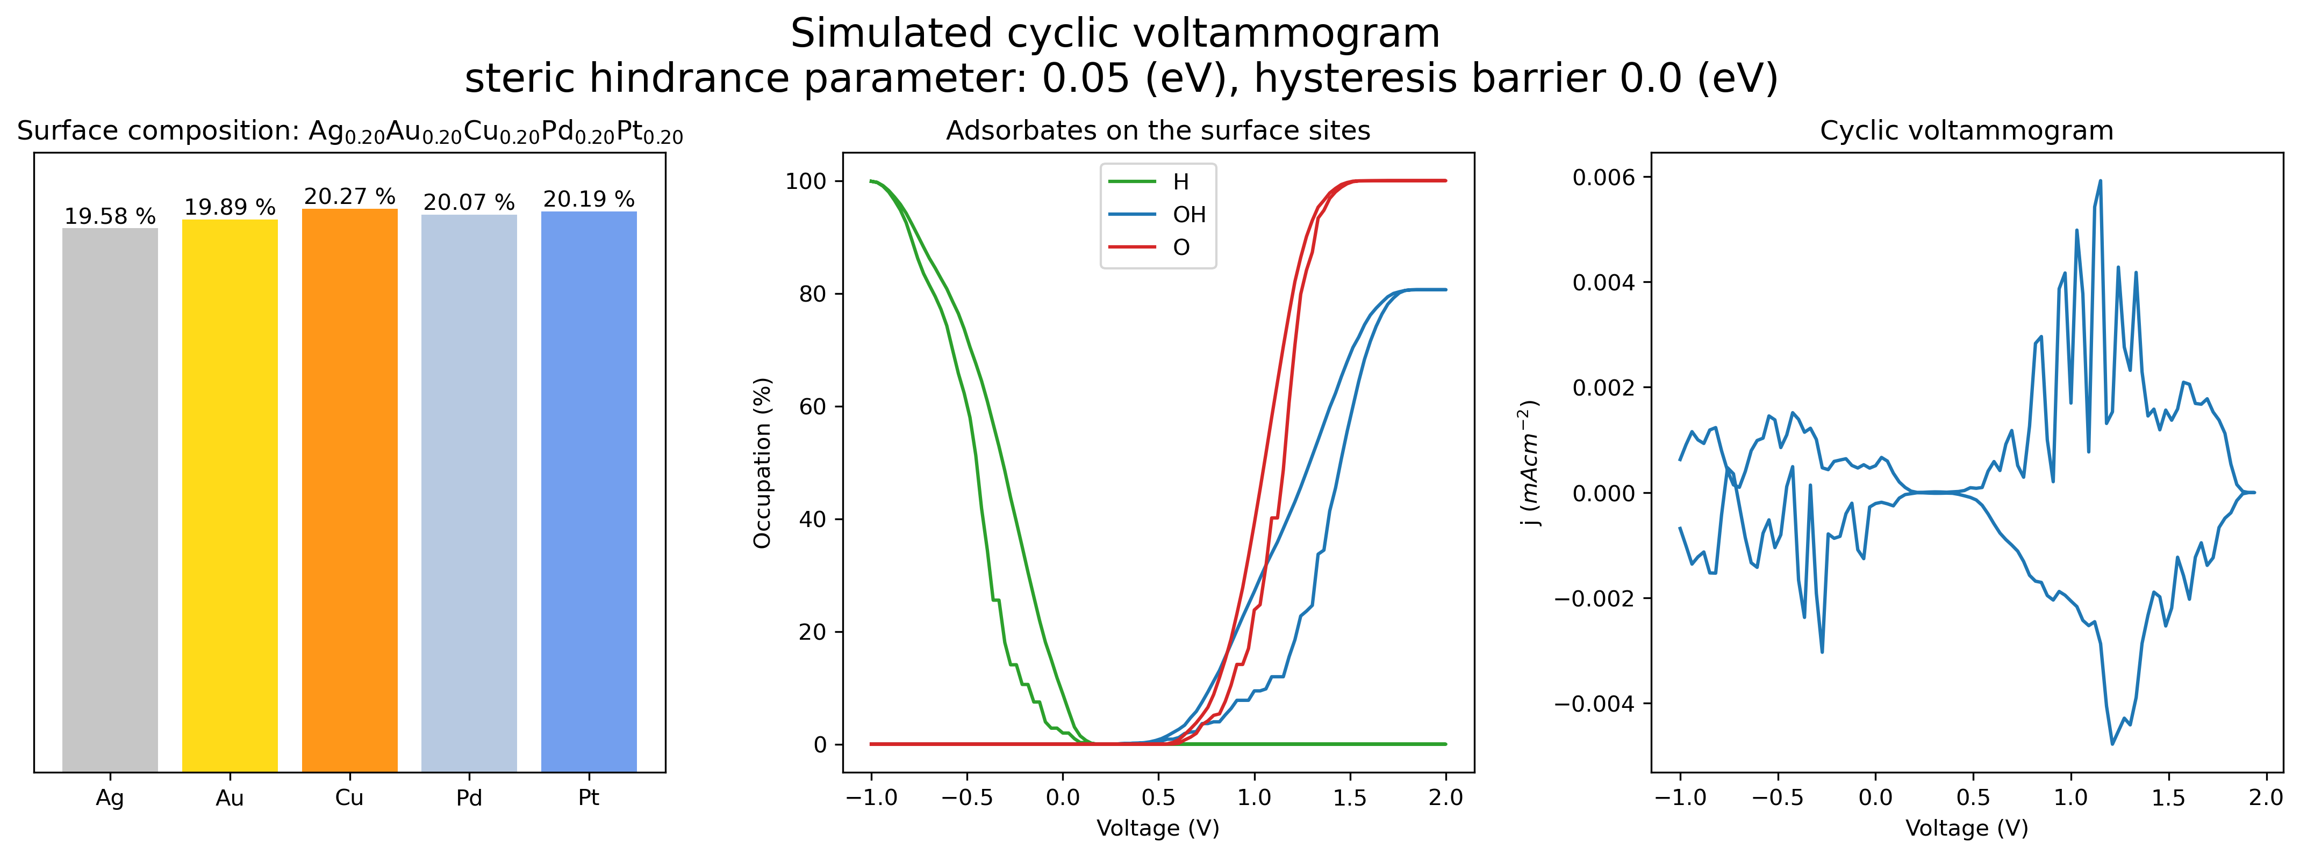
Simulating adsorbtion while varying voltage

